Slide 1
Applying AI with Python
Alex Conway
alex@numberboost.com

Slide 2
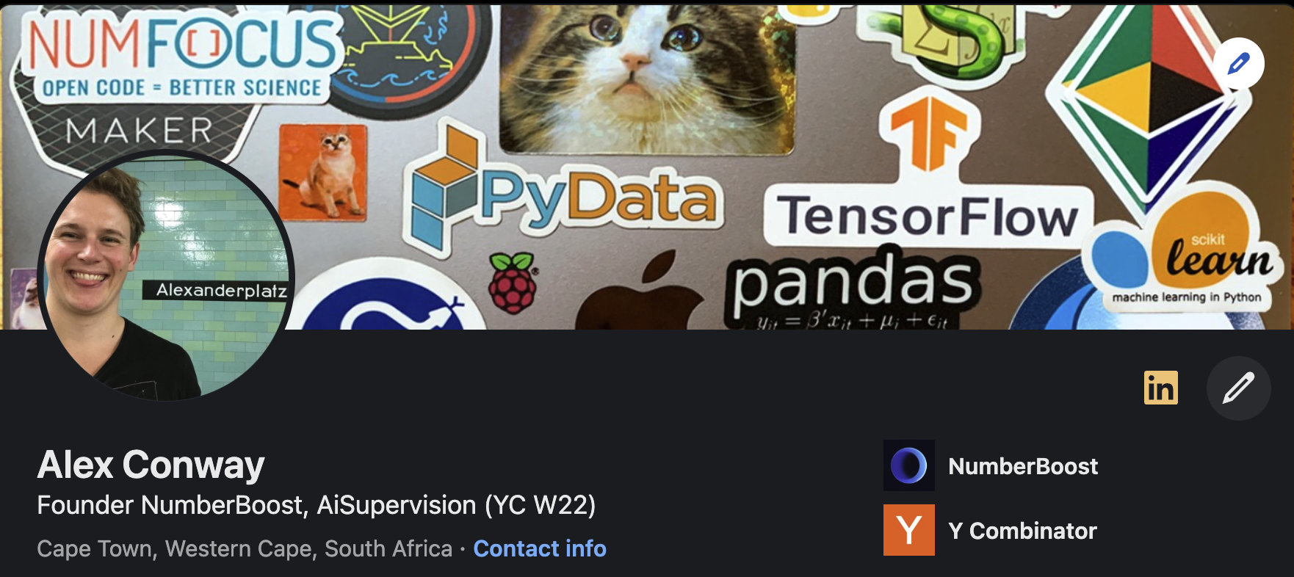
x.com/alxcnwy linkedin.com/in/alxcnwy/

Slide 3
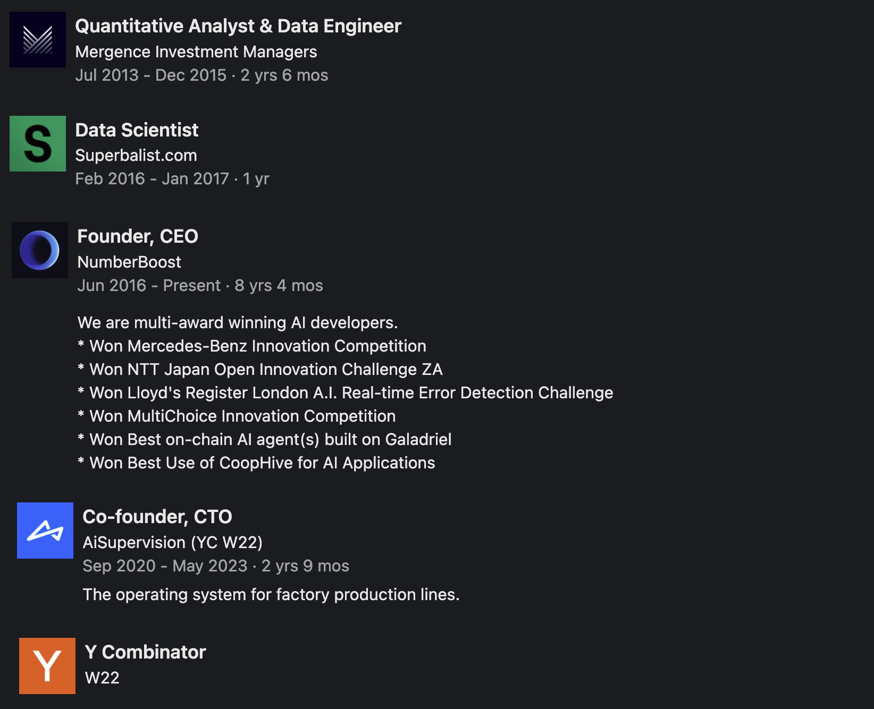

Slide 4
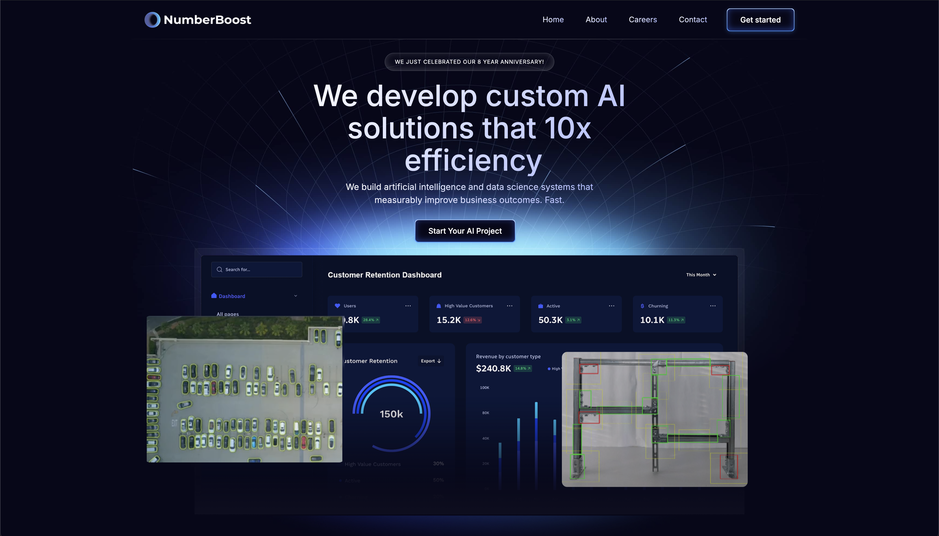

Slide 5

What is Artificial Intelligence (AI)?

Slide 6
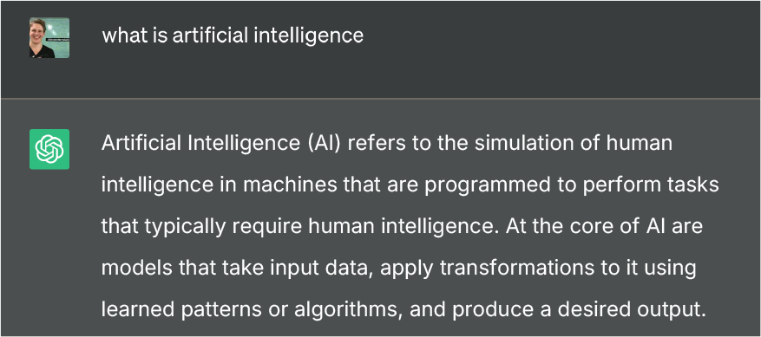

Slide 8

def ai_model(input):
#
# algorithms f(input) = output
#
return output

Slide 9
def ai_model(input):
#
# algorithms f(input) = output
#
return output

Slide 10
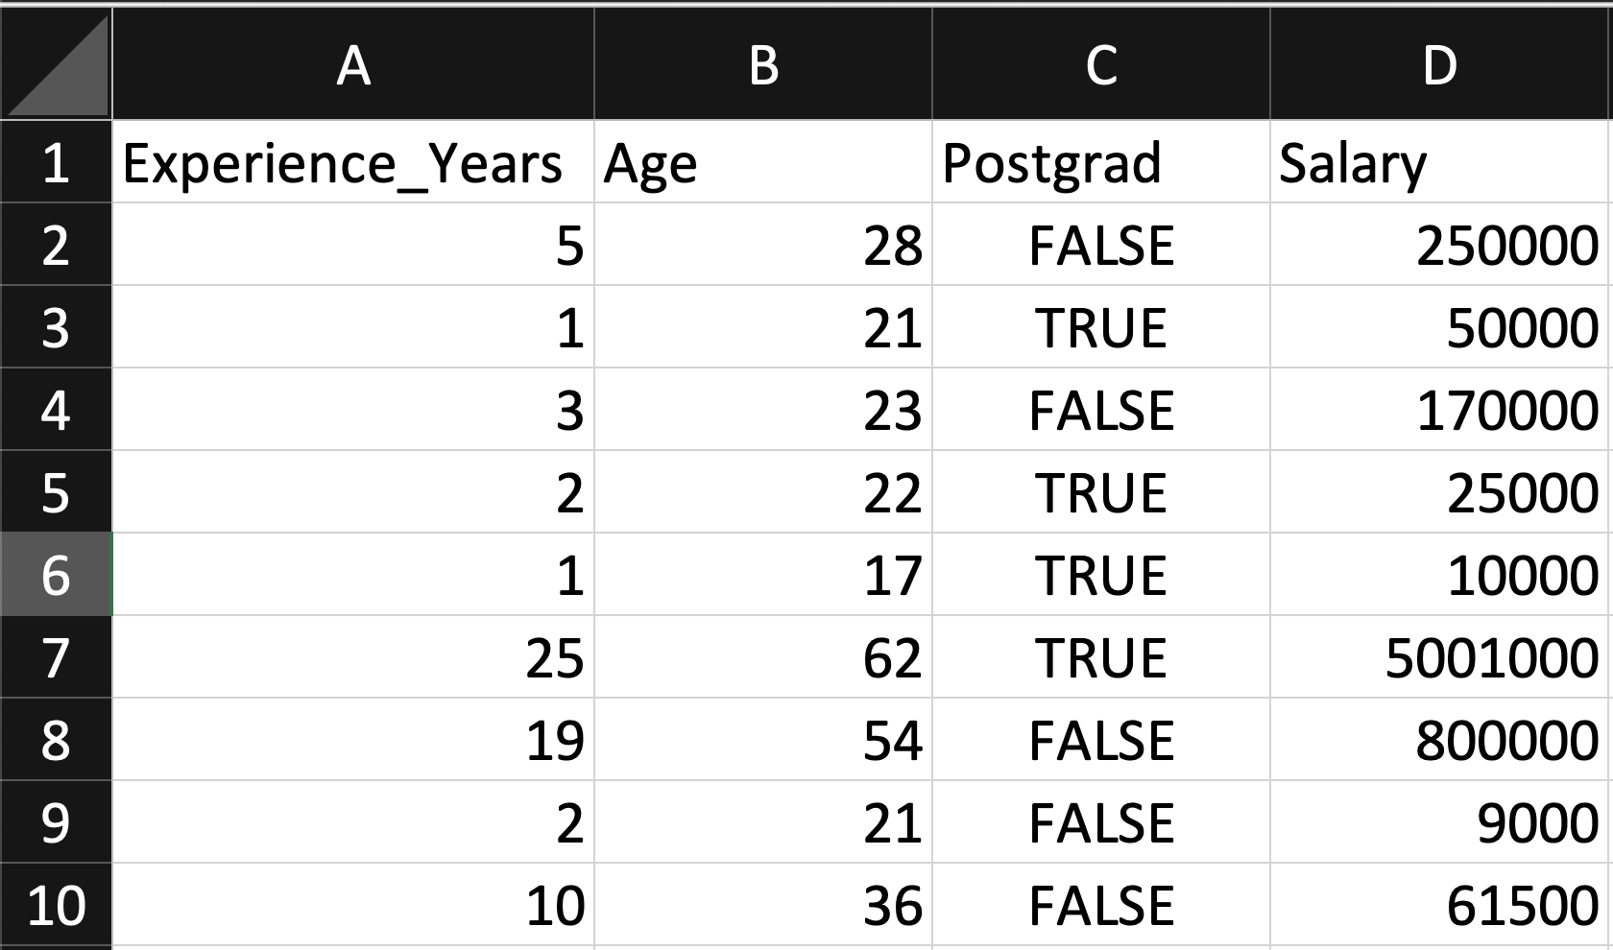
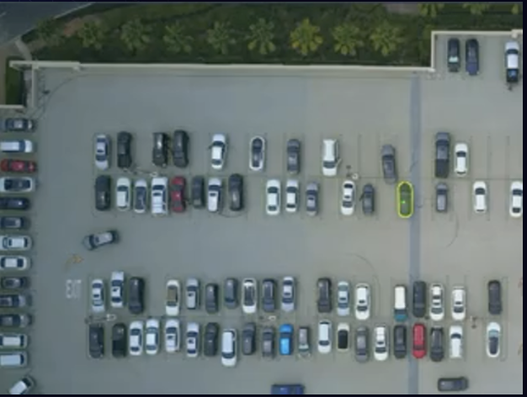
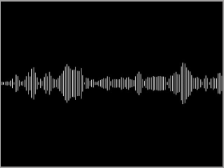
Input
Table
Image / Video
Artificial Intelligence (AI) is transforming industries and our lives by enabling computers to solve increasingly complex tasks, and Python stands at the forefront of this revolution. In this talk, we will explore how Python's rich ecosystem of AI libraries and frameworks can be harnessed to
Text
Audio

Slide 11
def ai_model(input):
#
# algorithms f(input) = output
#
return output

Slide 12
Algorithm Terminology
(Supervised) Regression (predict a number)
(Supervised) Classification (predict a category / label)
Unsupervised (find patterns within a dataset without labels)
Generative (create new data / content)

Slide 13
Types of AI Algorithms
Regression (Linear / Polynomial / Logistic, etc.)
Decision Trees (Random Forests, GBMs, etc.)
Clustering (K-Means, Spectral, DBSCAN, etc.)
Neural Networks (Convolutional, Recurrent, Transformer, etc.)
And more…

Slide 14
def ai_model(input):
#
# algorithms f(input) = output
#
return output

Slide 15
Output
Table
Image / Video
Artificial Intelligence (AI) is transforming industries and our lives by enabling computers to solve increasingly complex tasks, and Python stands at the forefront of this revolution. In this talk, we will explore how Python's rich ecosystem of AI libraries and frameworks can be harnessed to
Text
Audio

Slide 16
Output
Table
Image / Video
Artificial Intelligence (AI) is transforming industries and our lives by enabling computers to solve increasingly complex tasks, and Python stands at the forefront of this revolution. In this talk, we will explore how Python's rich ecosystem of AI libraries and frameworks can be harnessed to
Text
Audio

Slide 17
Output
Table
Image / Video
Artificial Intelligence (AI) is transforming industries and our lives by enabling computers to solve increasingly complex tasks, and Python stands at the forefront of this revolution. In this talk, we will explore how Python's rich ecosystem of AI libraries and frameworks can be harnessed to
Text
Audio

Slide 18
Output
Table
Image / Video
Artificial Intelligence (AI) is transforming industries and our lives by enabling computers to solve increasingly complex tasks, and Python stands at the forefront of this revolution. In this talk, we will explore how Python's rich ecosystem of AI libraries and frameworks can be harnessed to
Text
Audio

Slide 19
Output
Table
Image / Video
Artificial Intelligence (AI) is transforming industries and our lives by enabling computers to solve increasingly complex tasks, and Python stands at the forefront of this revolution. In this talk, we will explore how Python's rich ecosystem of AI libraries and frameworks can be harnessed to
Text
Audio

Slide 20
Output
Table
Image / Video
Artificial Intelligence (AI) is transforming industries and our lives by enabling computers to solve increasingly complex tasks, and Python stands at the forefront of this revolution. In this talk, we will explore how Python's rich ecosystem of AI libraries and frameworks can be harnessed to
Text
Audio

Slide 21
Output
Table
Image / Video
Artificial Intelligence (AI) is transforming industries and our lives by enabling computers to solve increasingly complex tasks, and Python stands at the forefront of this revolution. In this talk, we will explore how Python's rich ecosystem of AI libraries and frameworks can be harnessed to
Text
Audio

Slide 22
Output
Table
Image / Video
Artificial Intelligence (AI) is transforming industries and our lives by enabling computers to solve increasingly complex tasks, and Python stands at the forefront of this revolution. In this talk, we will explore how Python's rich ecosystem of AI libraries and frameworks can be harnessed to
Text
Audio

Slide 23
Output
Table
Image / Video
Artificial Intelligence (AI) is transforming industries and our lives by enabling computers to solve increasingly complex tasks, and Python stands at the forefront of this revolution. In this talk, we will explore how Python's rich ecosystem of AI libraries and frameworks can be harnessed to
Text
Audio

Slide 24
Output
Table
Image / Video
Artificial Intelligence (AI) is transforming industries and our lives by enabling computers to solve increasingly complex tasks, and Python stands at the forefront of this revolution. In this talk, we will explore how Python's rich ecosystem of AI libraries and frameworks can be harnessed to
Text
Audio

Slide 25




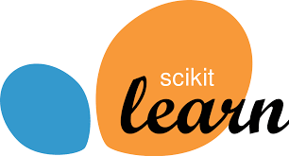



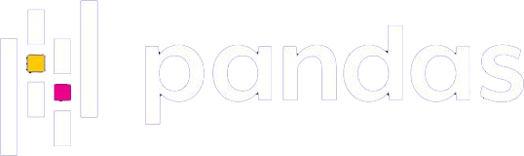
Why Python for AI?
Easy to use (ML researchers typically not software engineers)
Massive community (easy to find answers to questions)
Extensive libraries and frameworks (don’t need to invent to use)

Slide 26
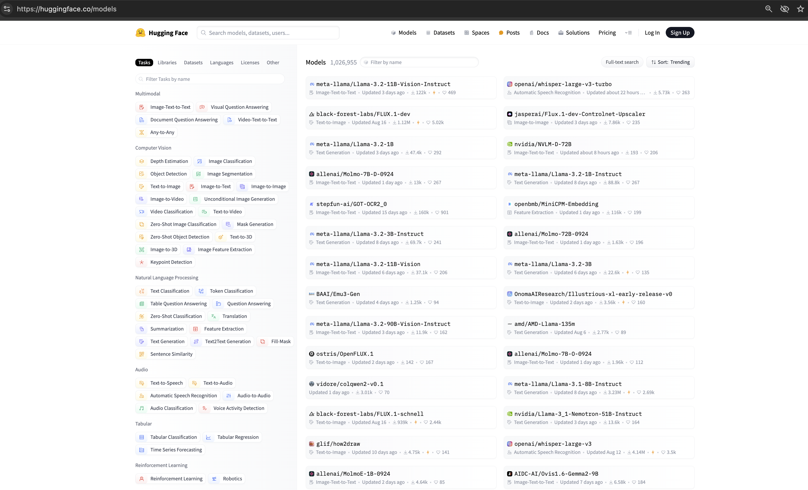

Slide 27
Image/
Video
Text
Audio
Table

Slide 28
Table Data

Slide 29
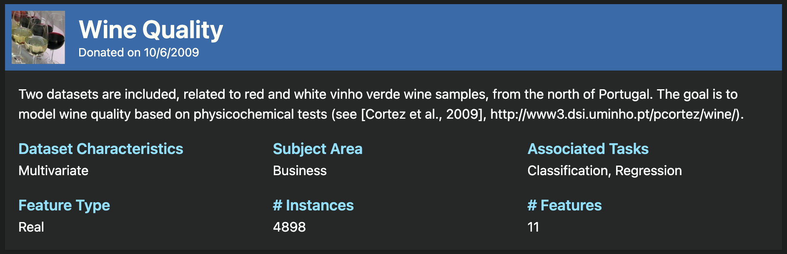
https://archive.ics.uci.edu/dataset/186/wine+quality

Slide 30
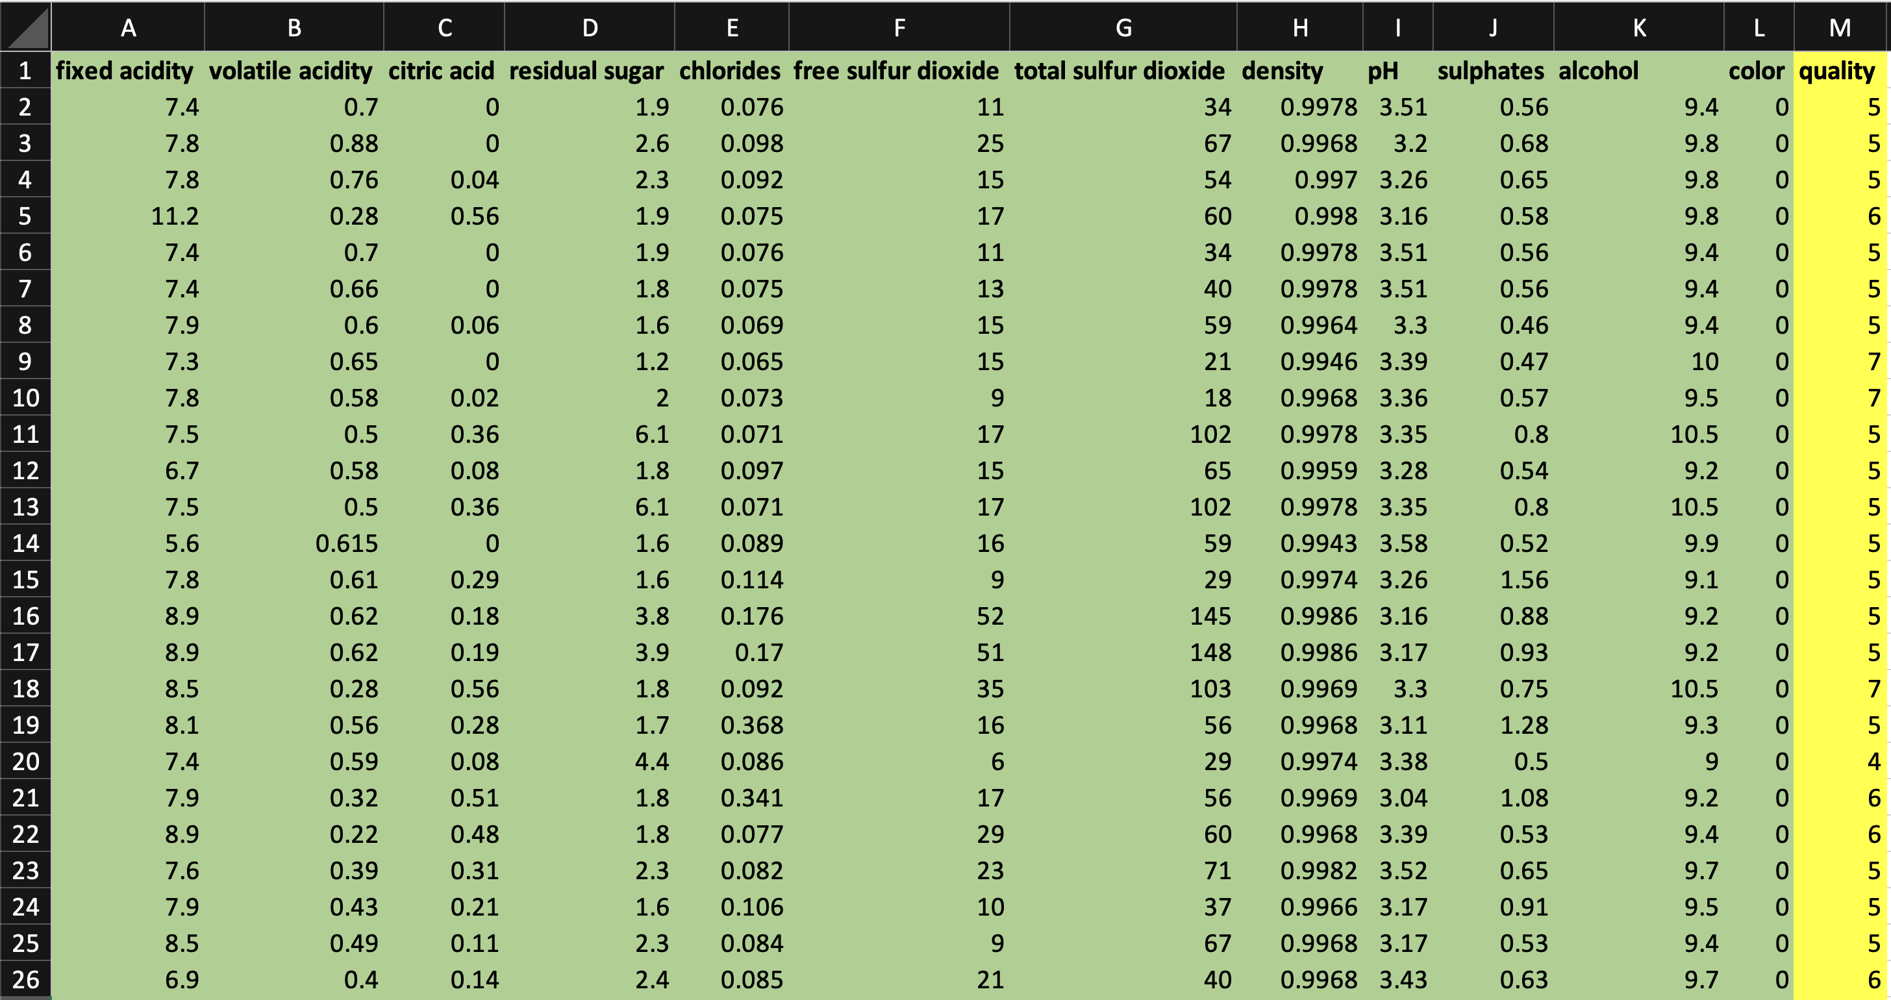
Regression Model
to Predict Wine Quality

Slide 31
Jupyter Notebook
TableData.ipynb

Slide 32
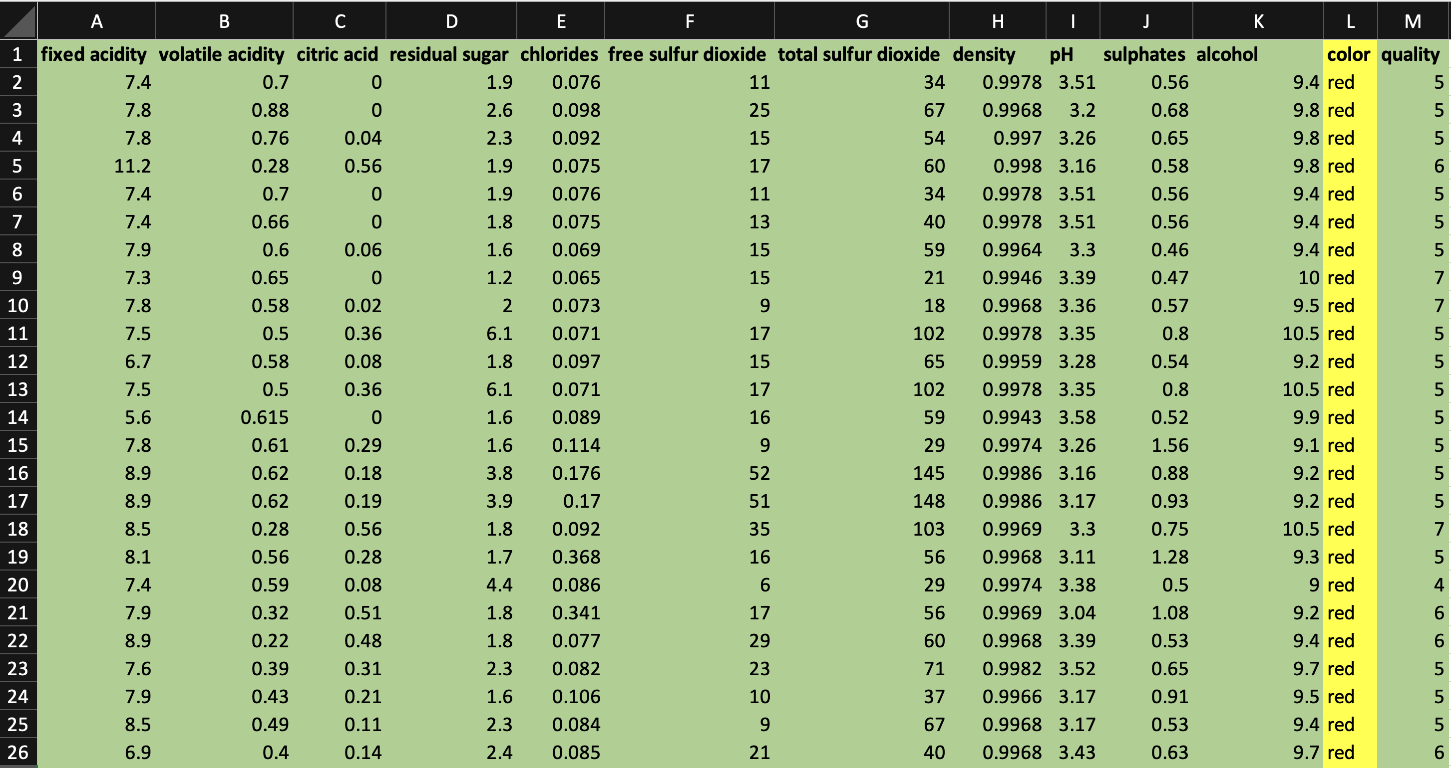
Classification Model
to Predict Wine Colour

Slide 33
Jupyter Notebook
TableData.ipynb

Slide 34
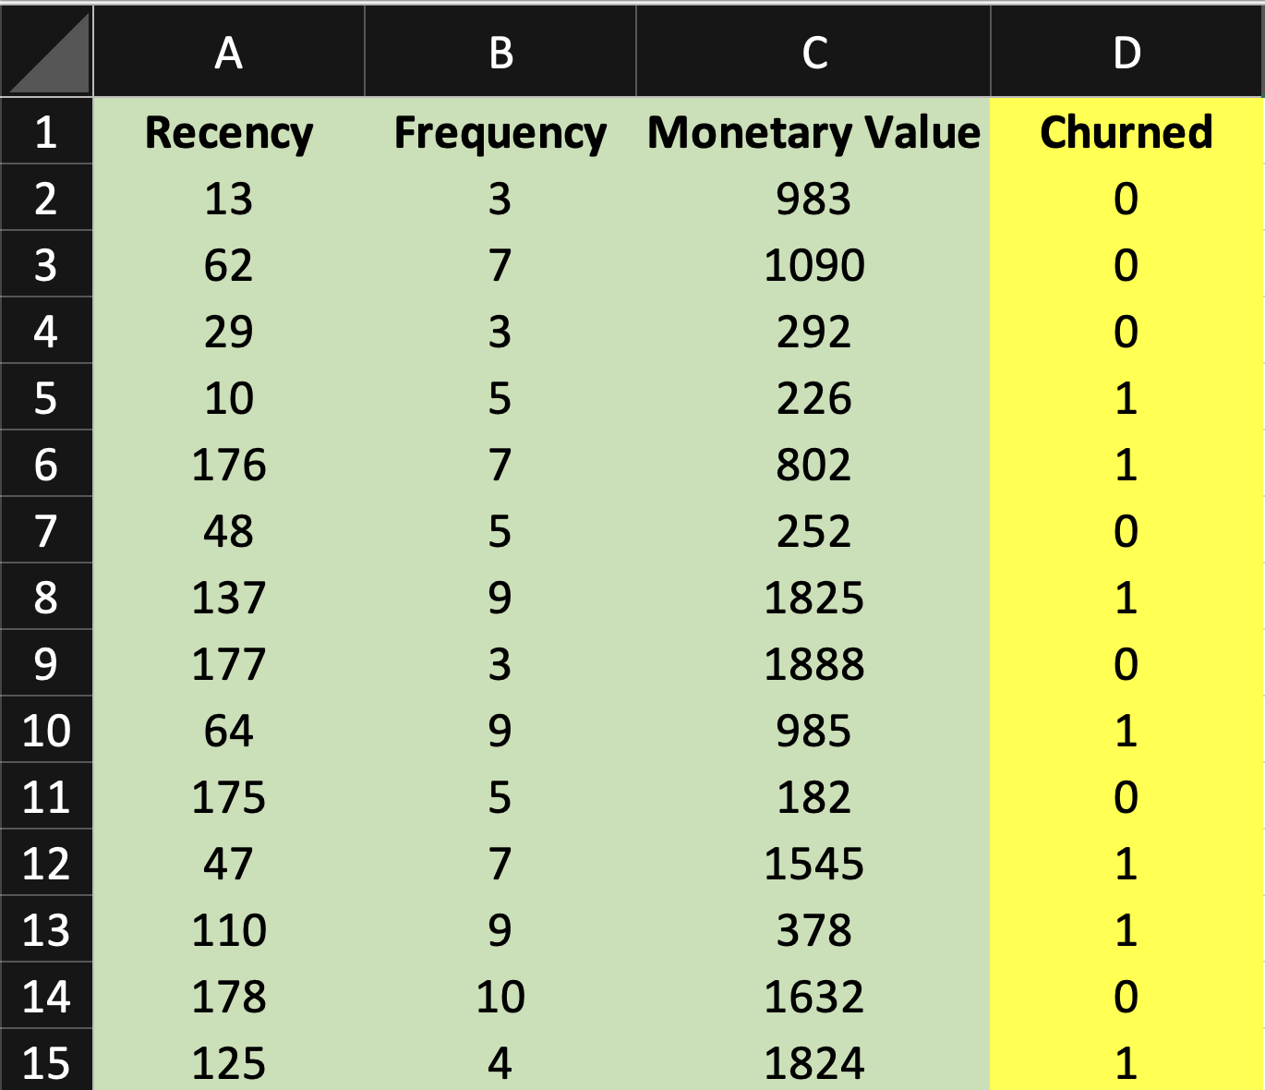

Slide 35

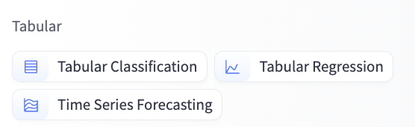

Slide 36
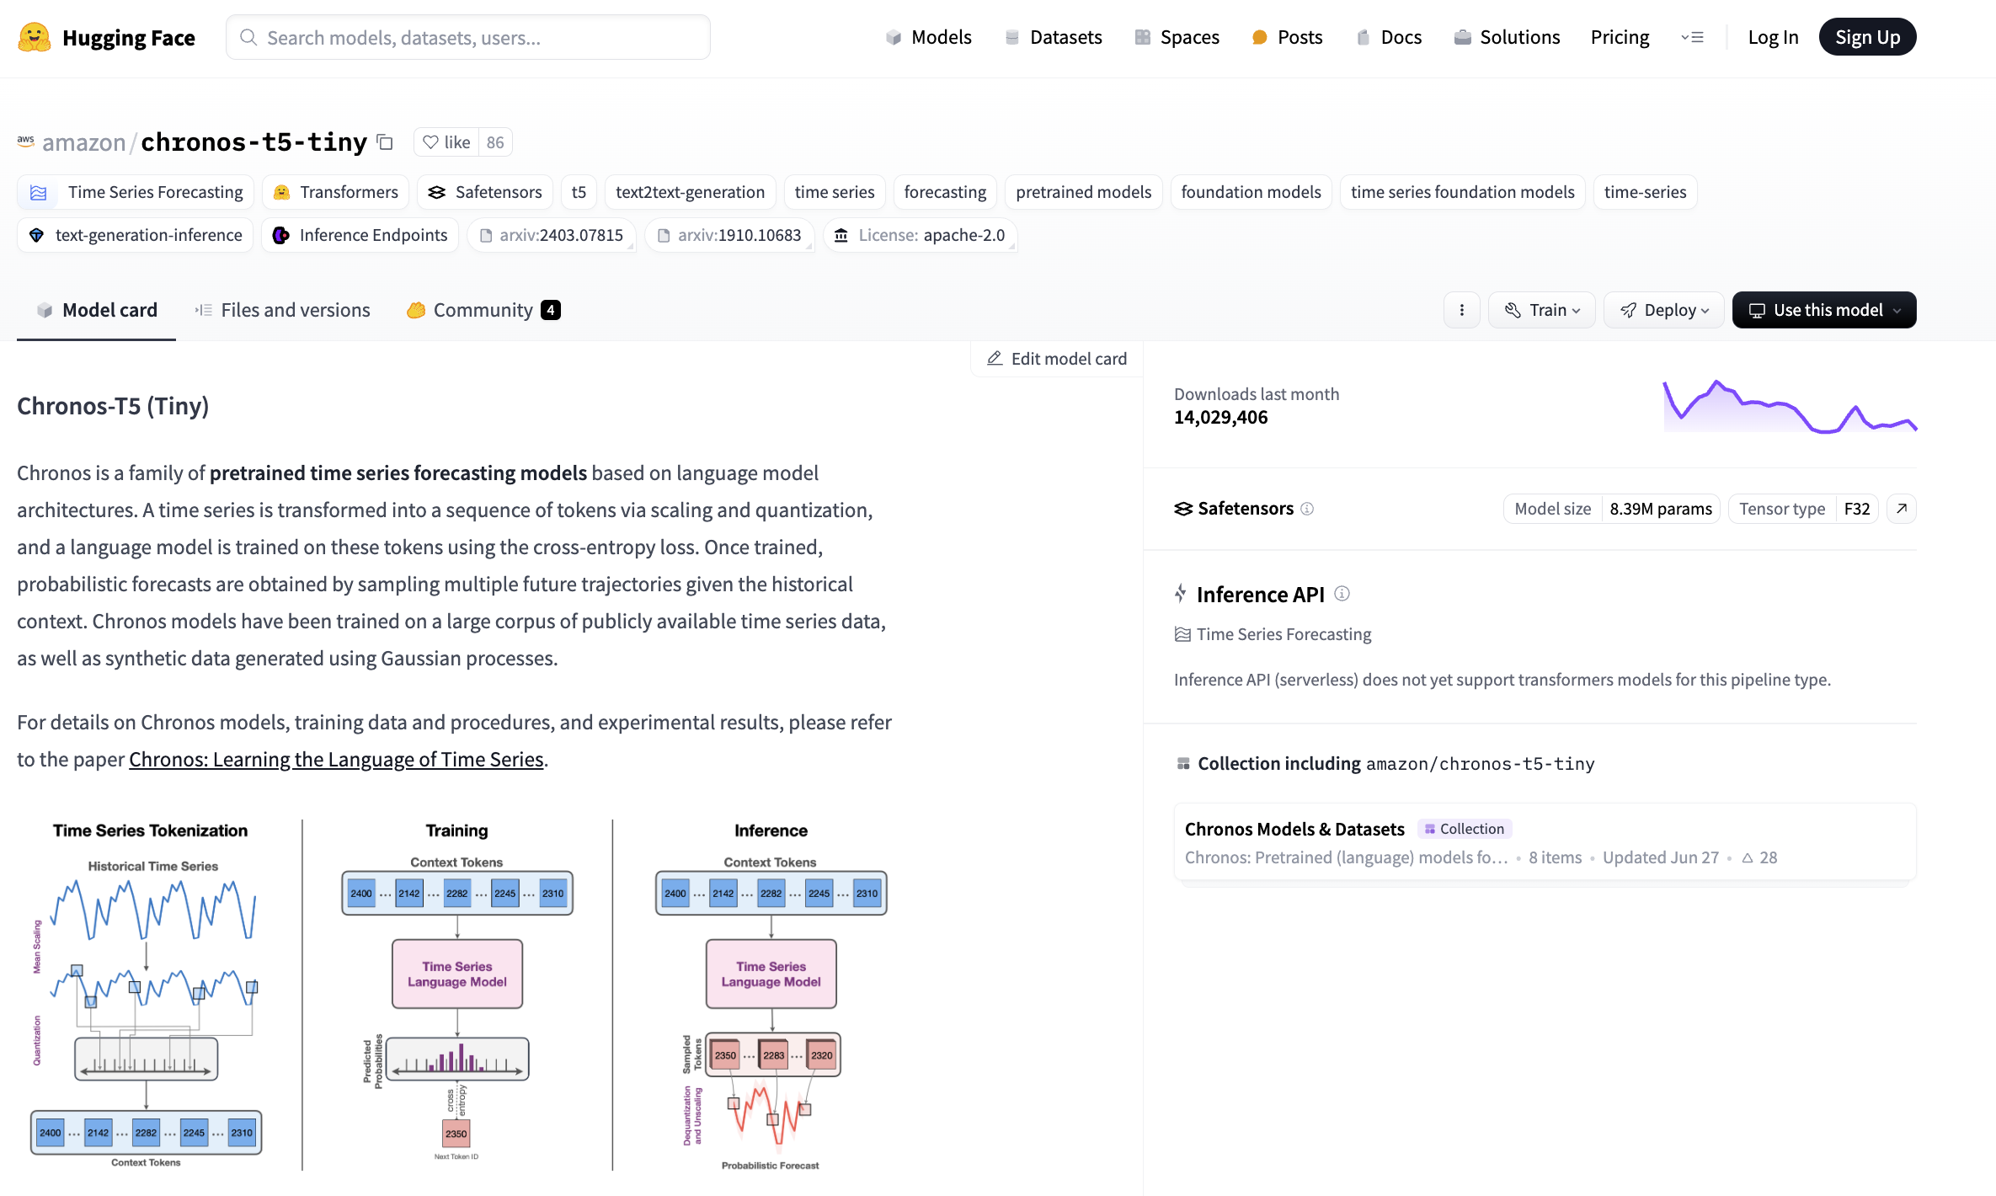

Slide 37
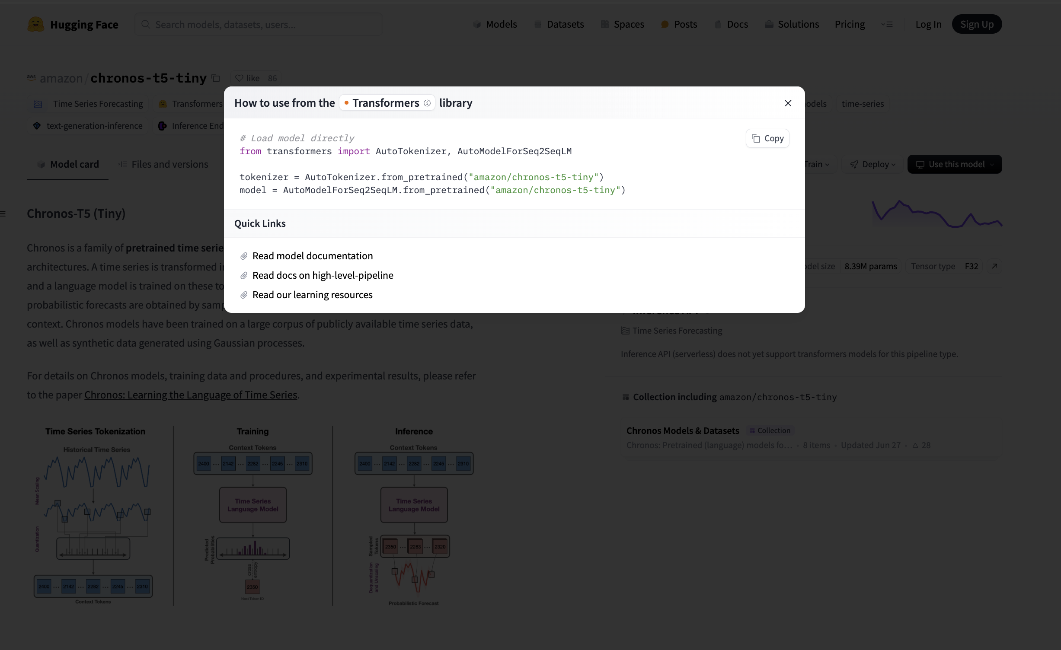

Slide 38
Image / Video Data

Slide 39
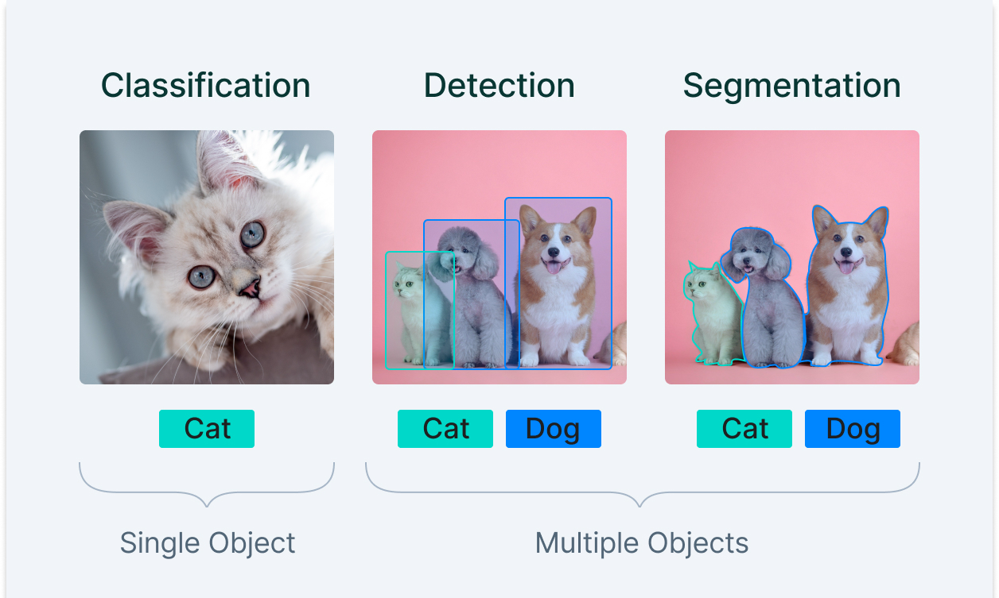

Slide 40
Jupyter Notebook
Classification and Visual Search.ipynb

Slide 41
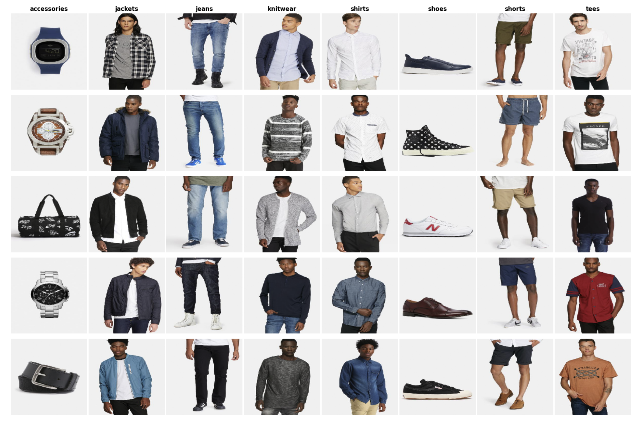

Slide 42
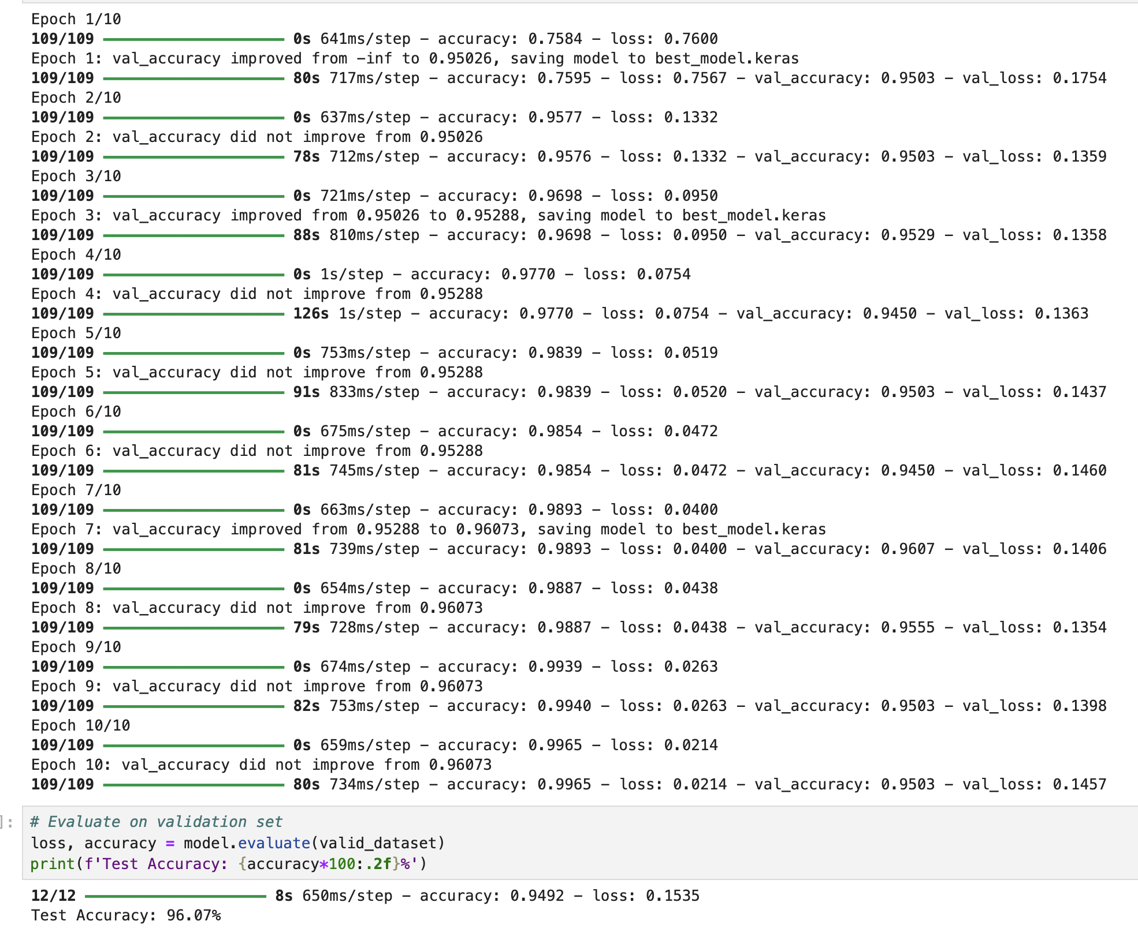

Slide 43
Embeddings
TODO

Slide 44
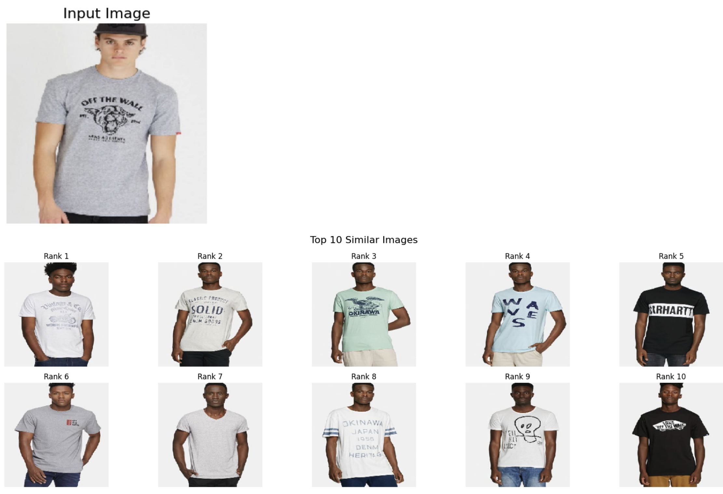

Slide 45
Jupyter Notebook
Object Detection.ipynb

Slide 46
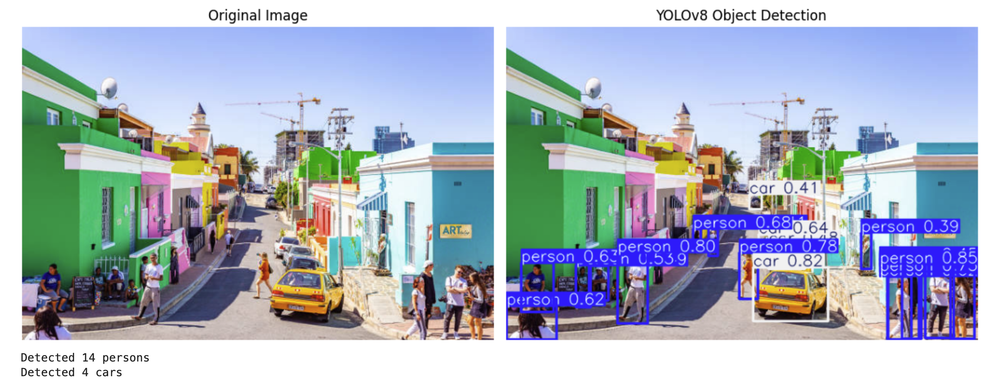

Slide 47
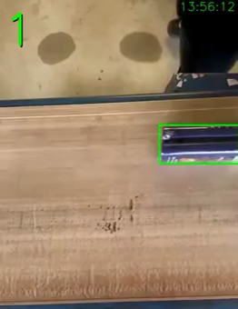

Slide 48

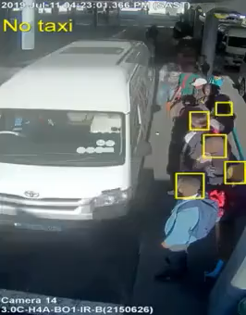

Slide 49
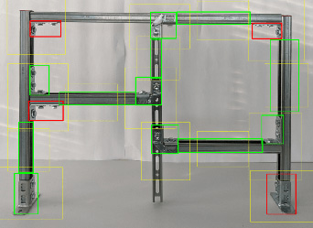

Slide 50
Jupyter Notebook
Segmentation.ipynb

Slide 51
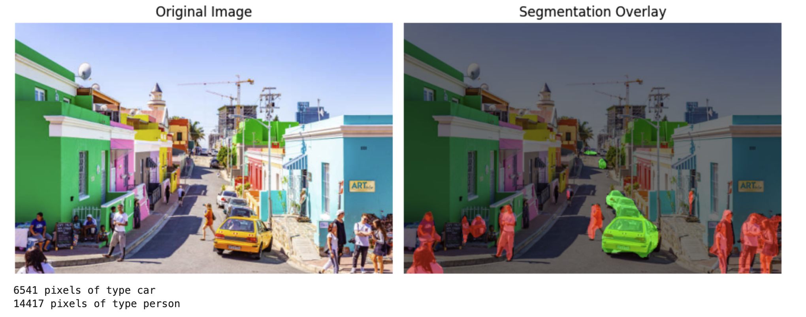

Slide 52
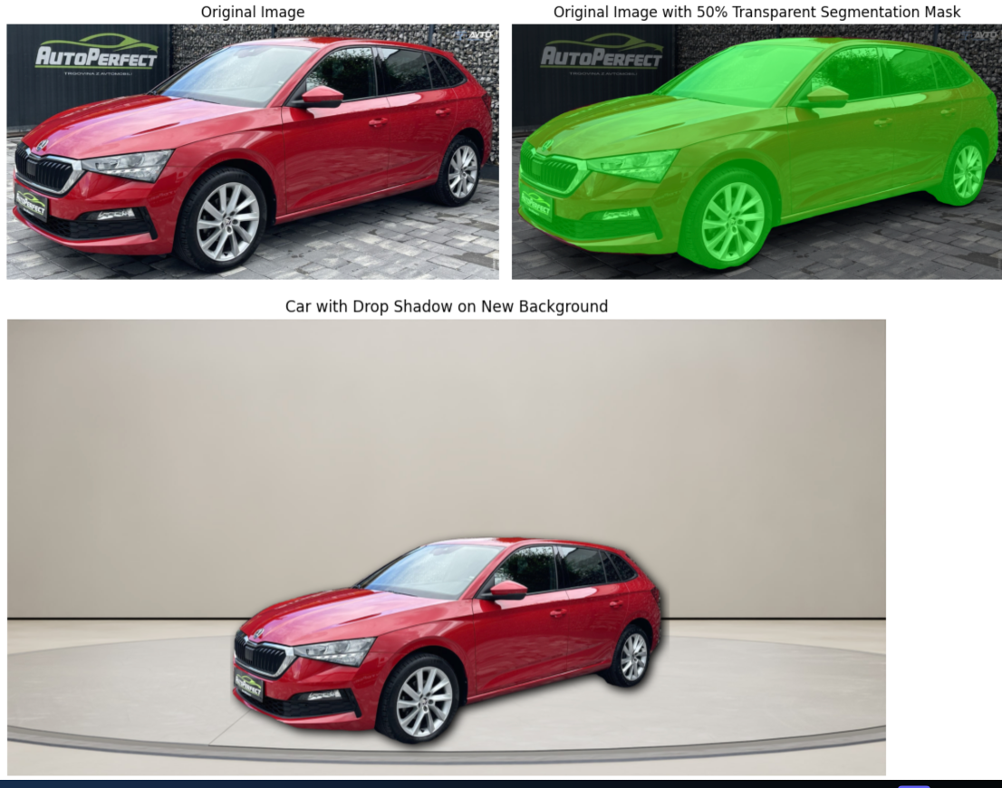

Slide 53
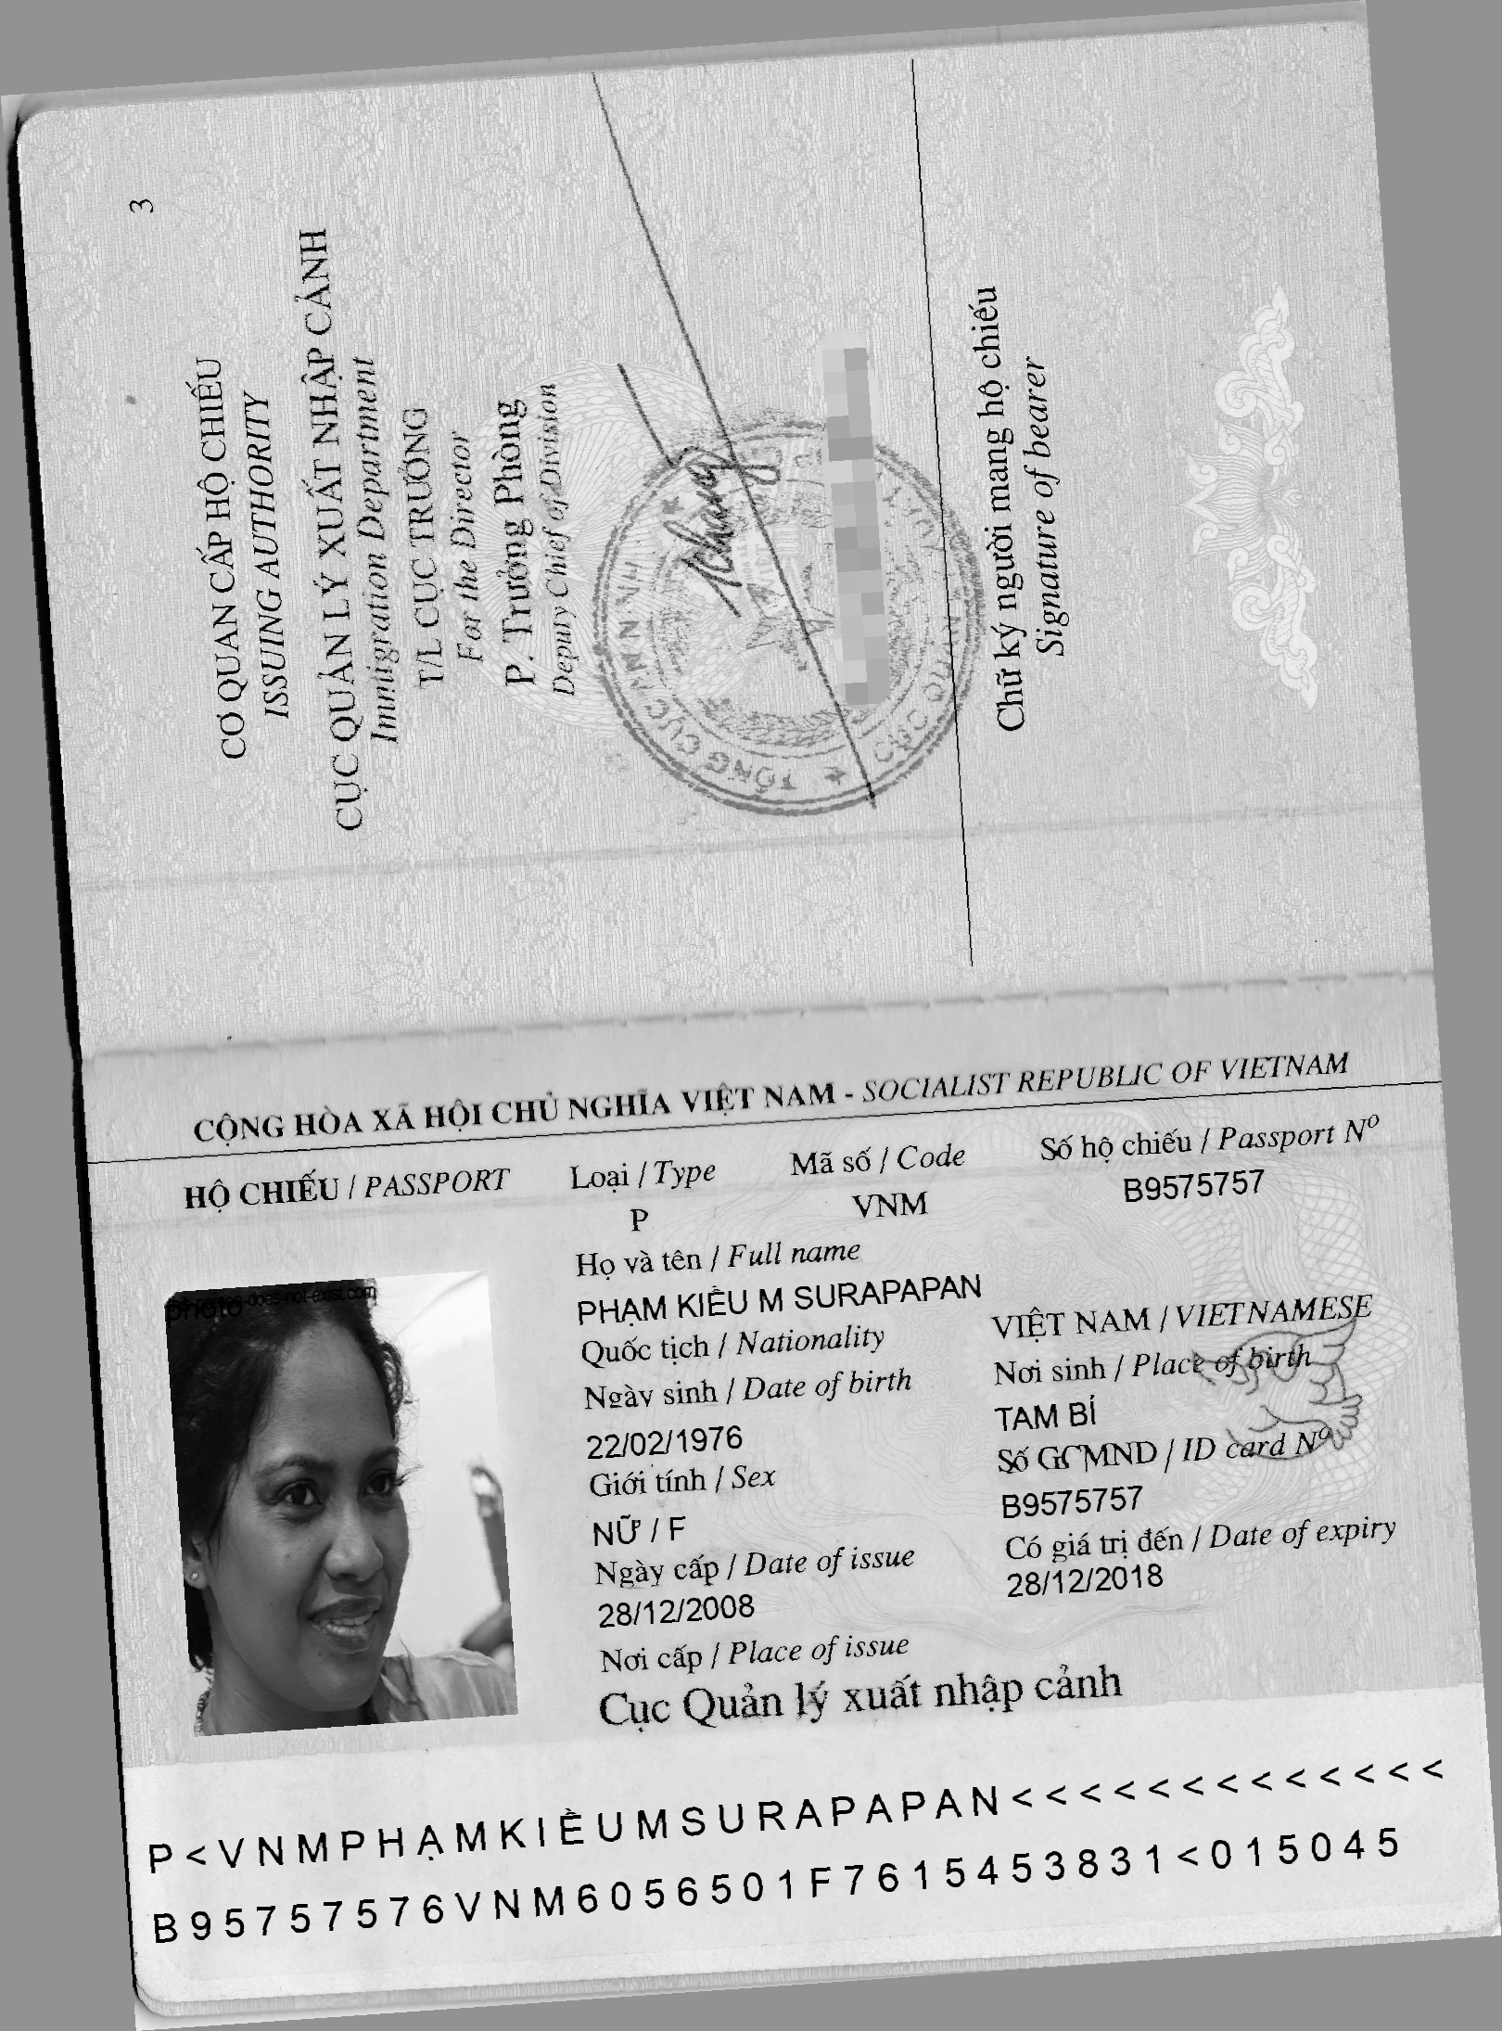
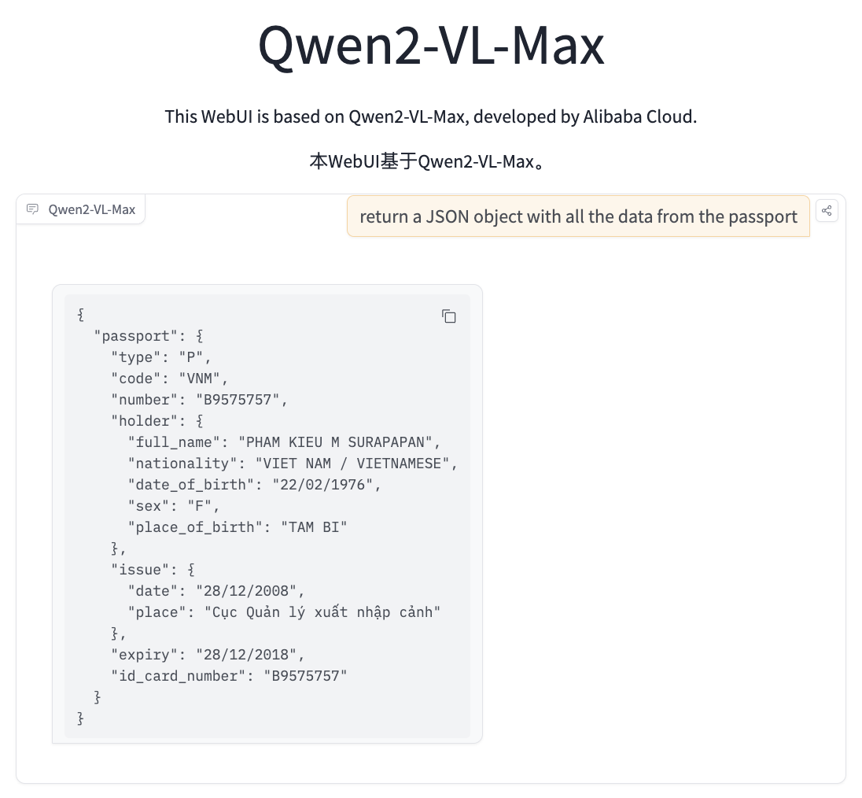

Slide 54
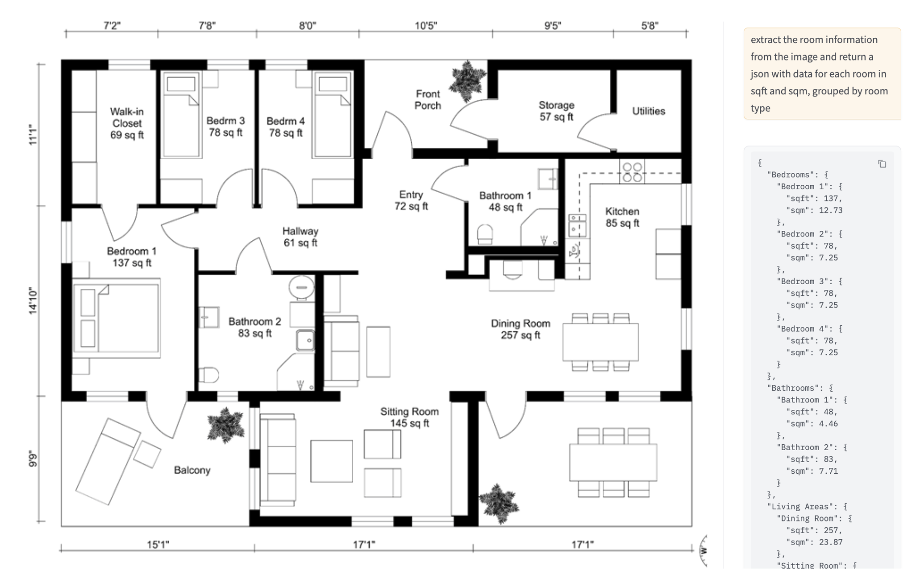

Slide 55
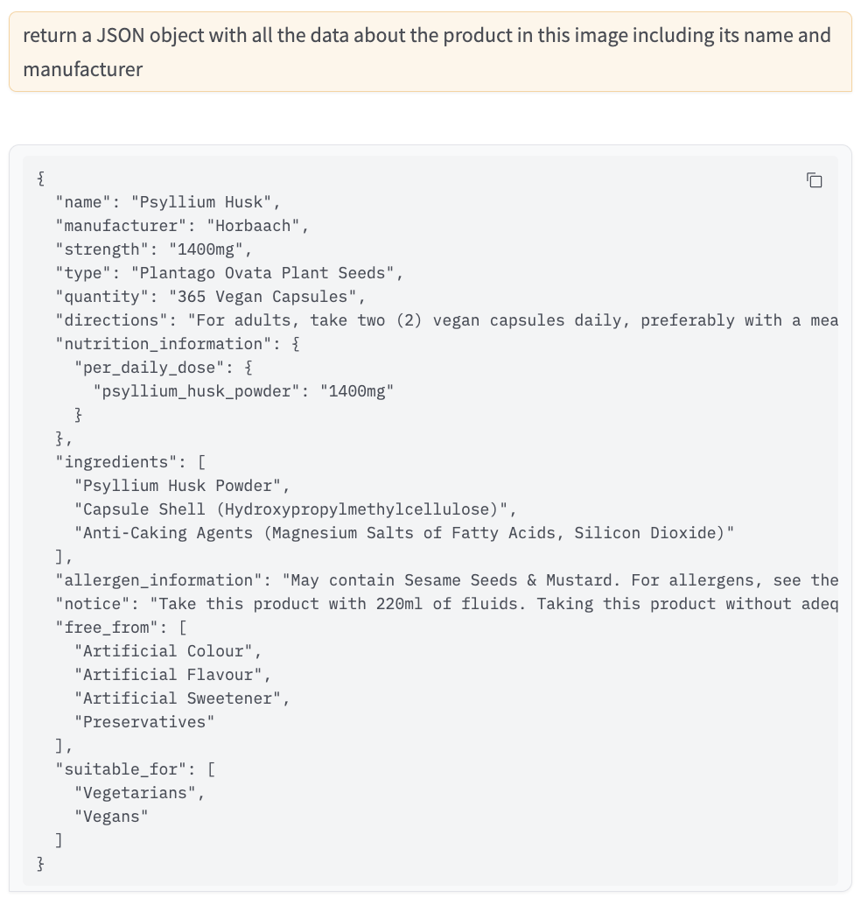


Slide 56
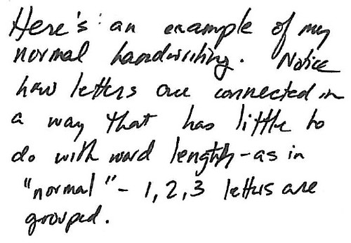
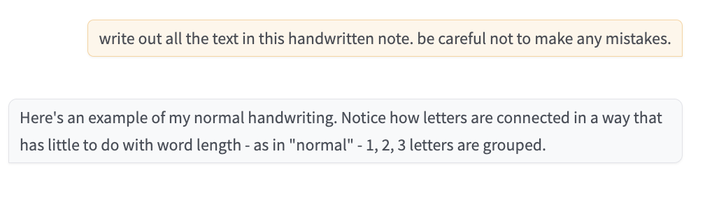

Slide 57
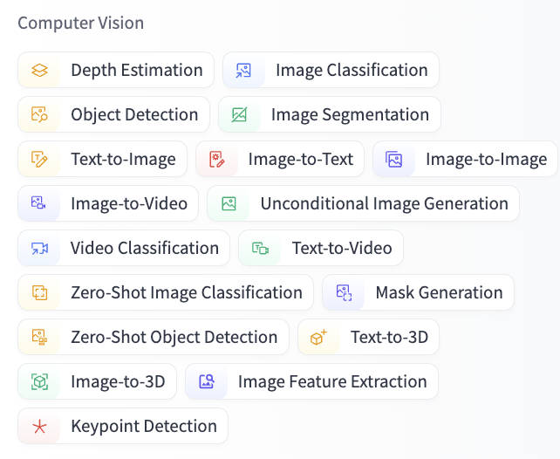

Slide 58
Speech Data

Slide 59
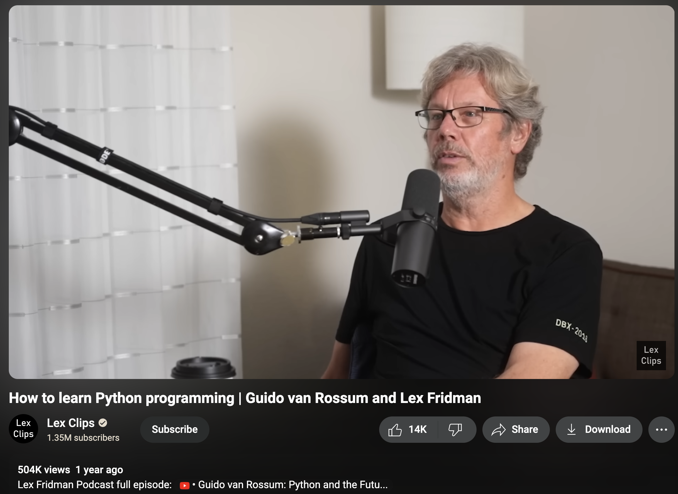

Slide 60
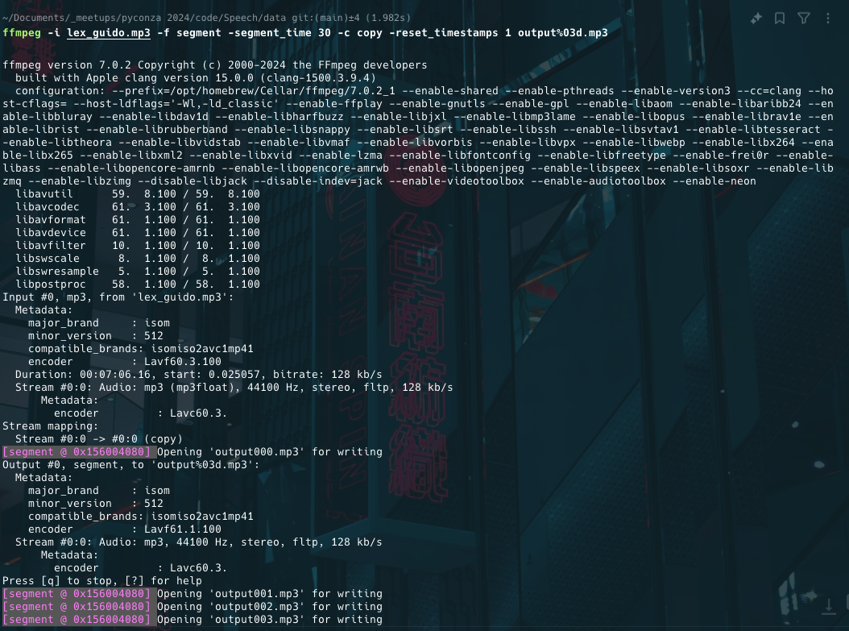

Slide 61
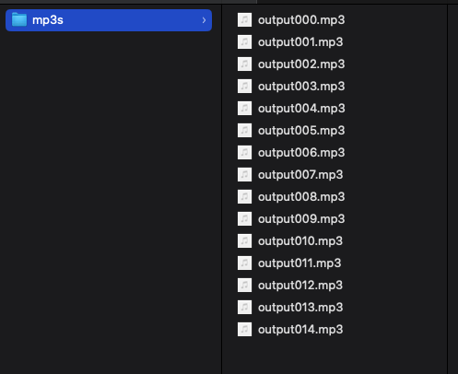

Slide 62
Jupyter Notebook
Transcribe.ipynb

Slide 63
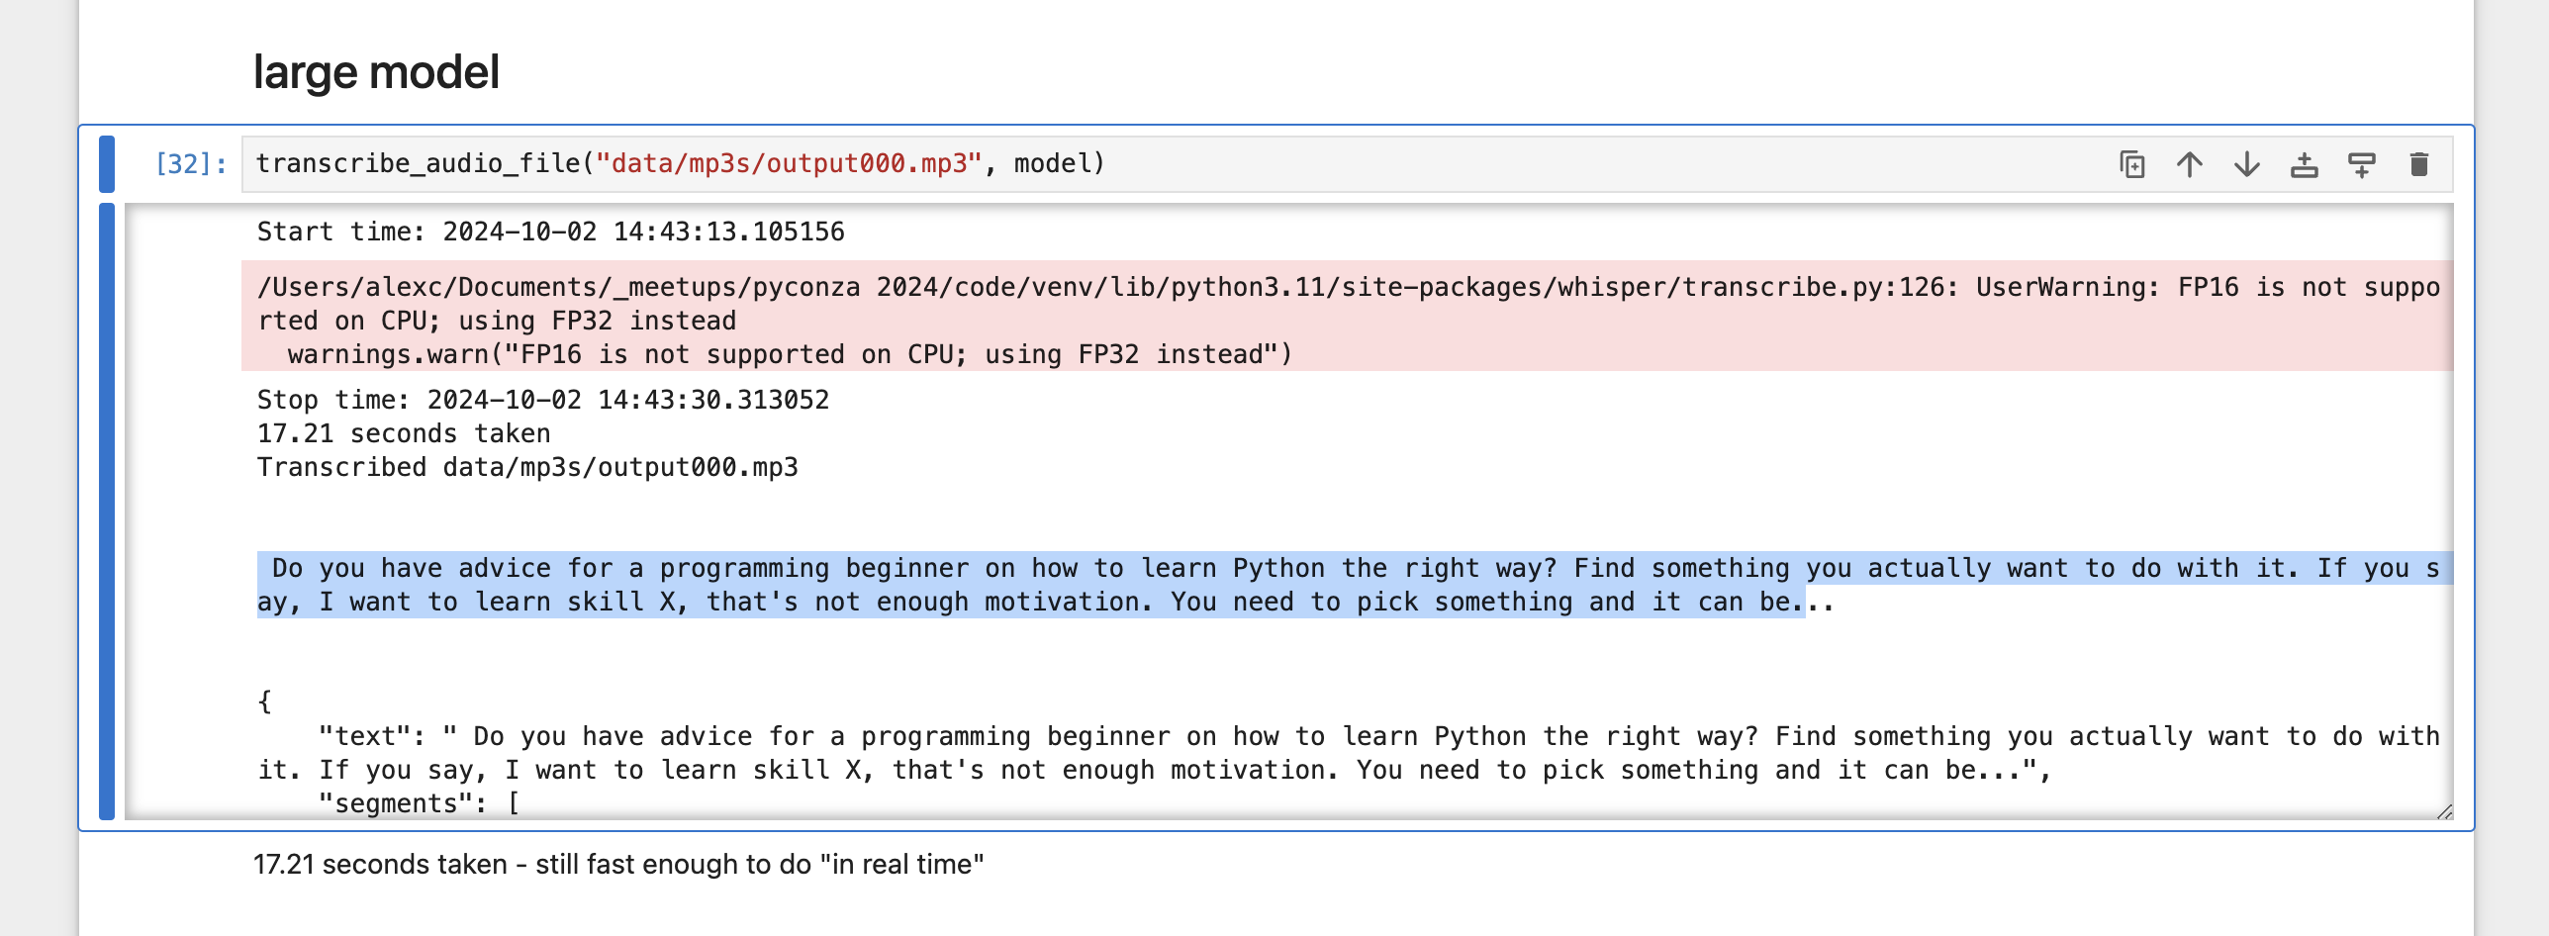

Slide 64
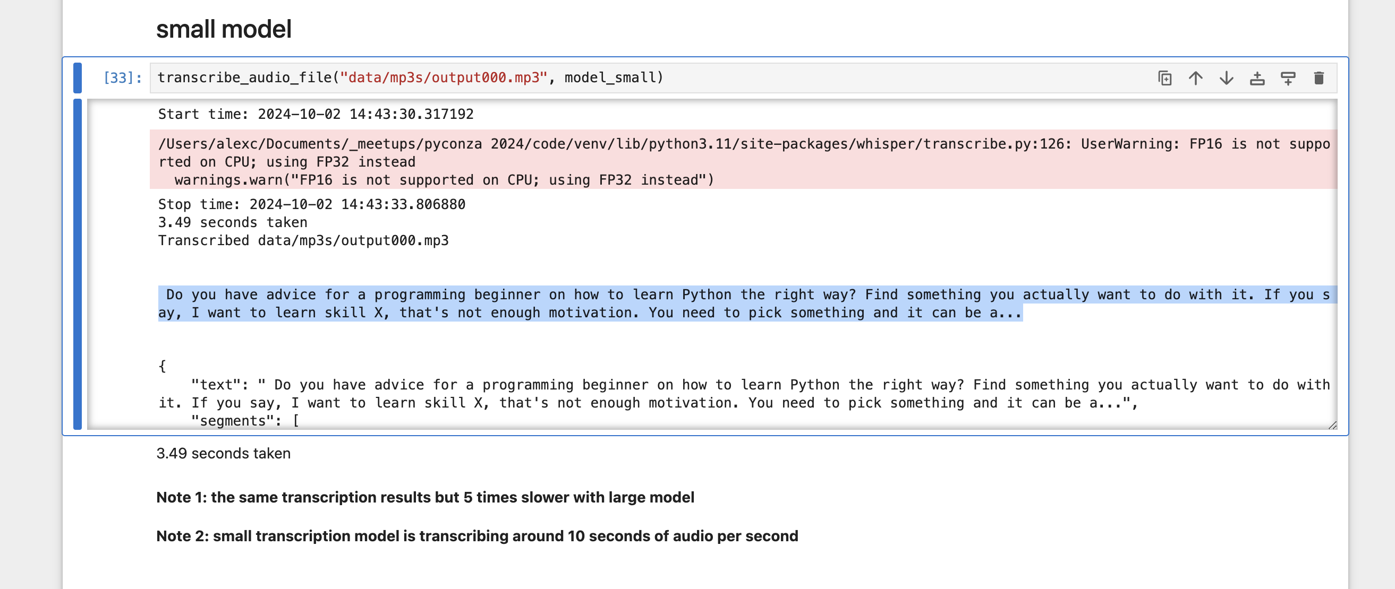

Slide 65
Jupyter Notebook
https://github.com/mbamvianney/SPEECH-EMOTION-RECOGNITION-WITH-MACHINE-LEARNING

Slide 66
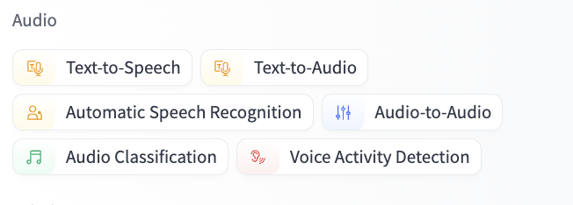

Slide 67
Text Data

Slide 68
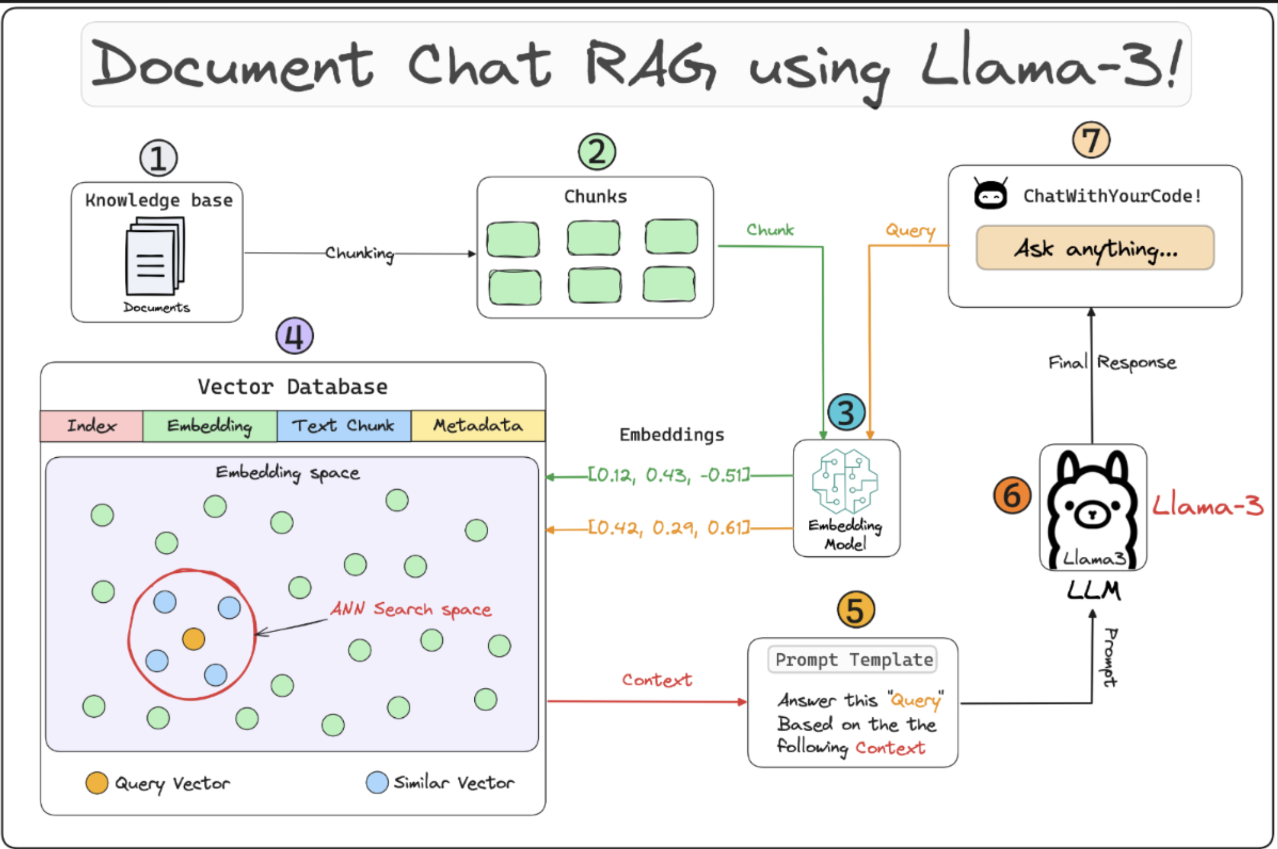
lightning.ai/lightning-ai/studios/rag-using-llama-3-2-by-meta-ai

Slide 69
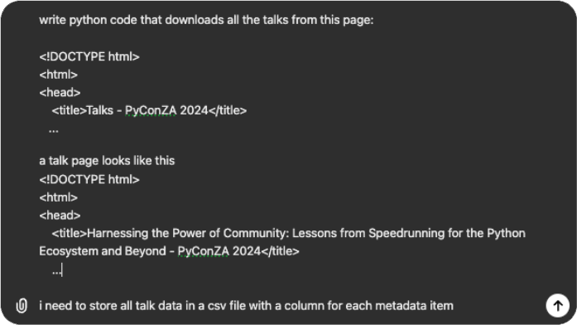
talks.html
talk.html

Slide 70
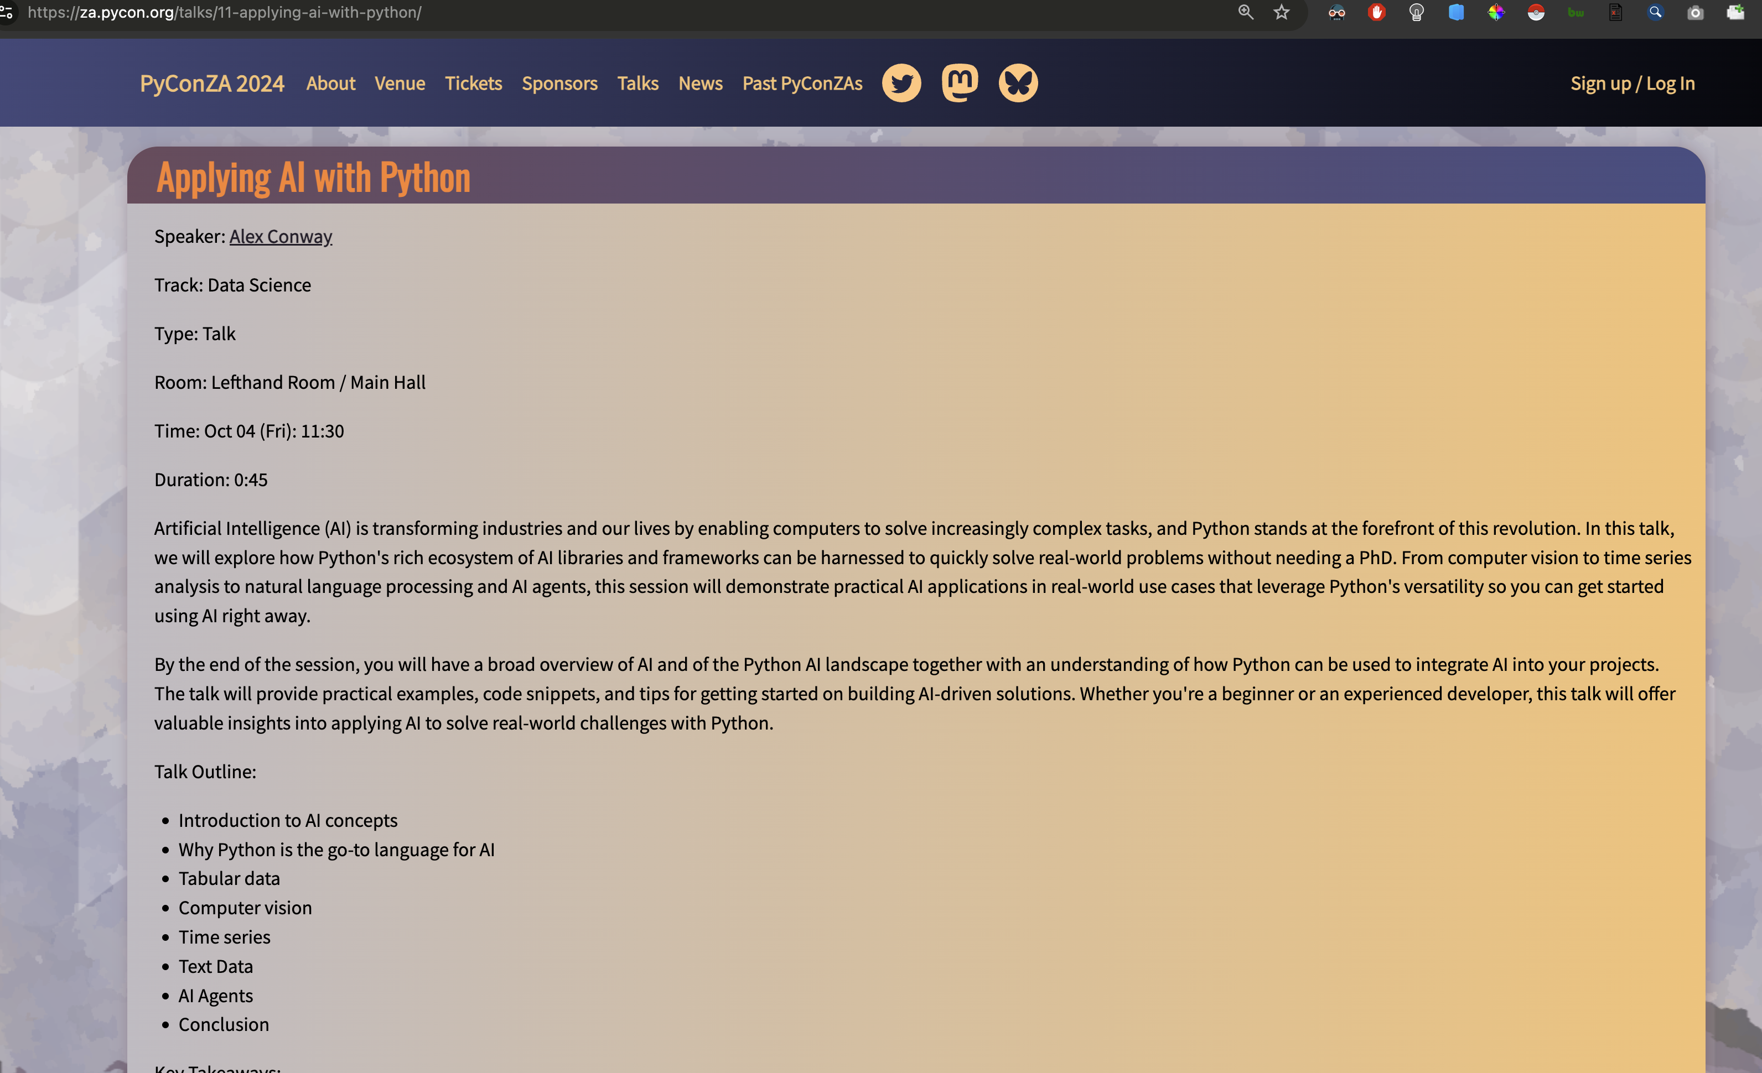

Slide 71
Jupyter Notebook
Scrape PyConZA2024.ipynb

Slide 72
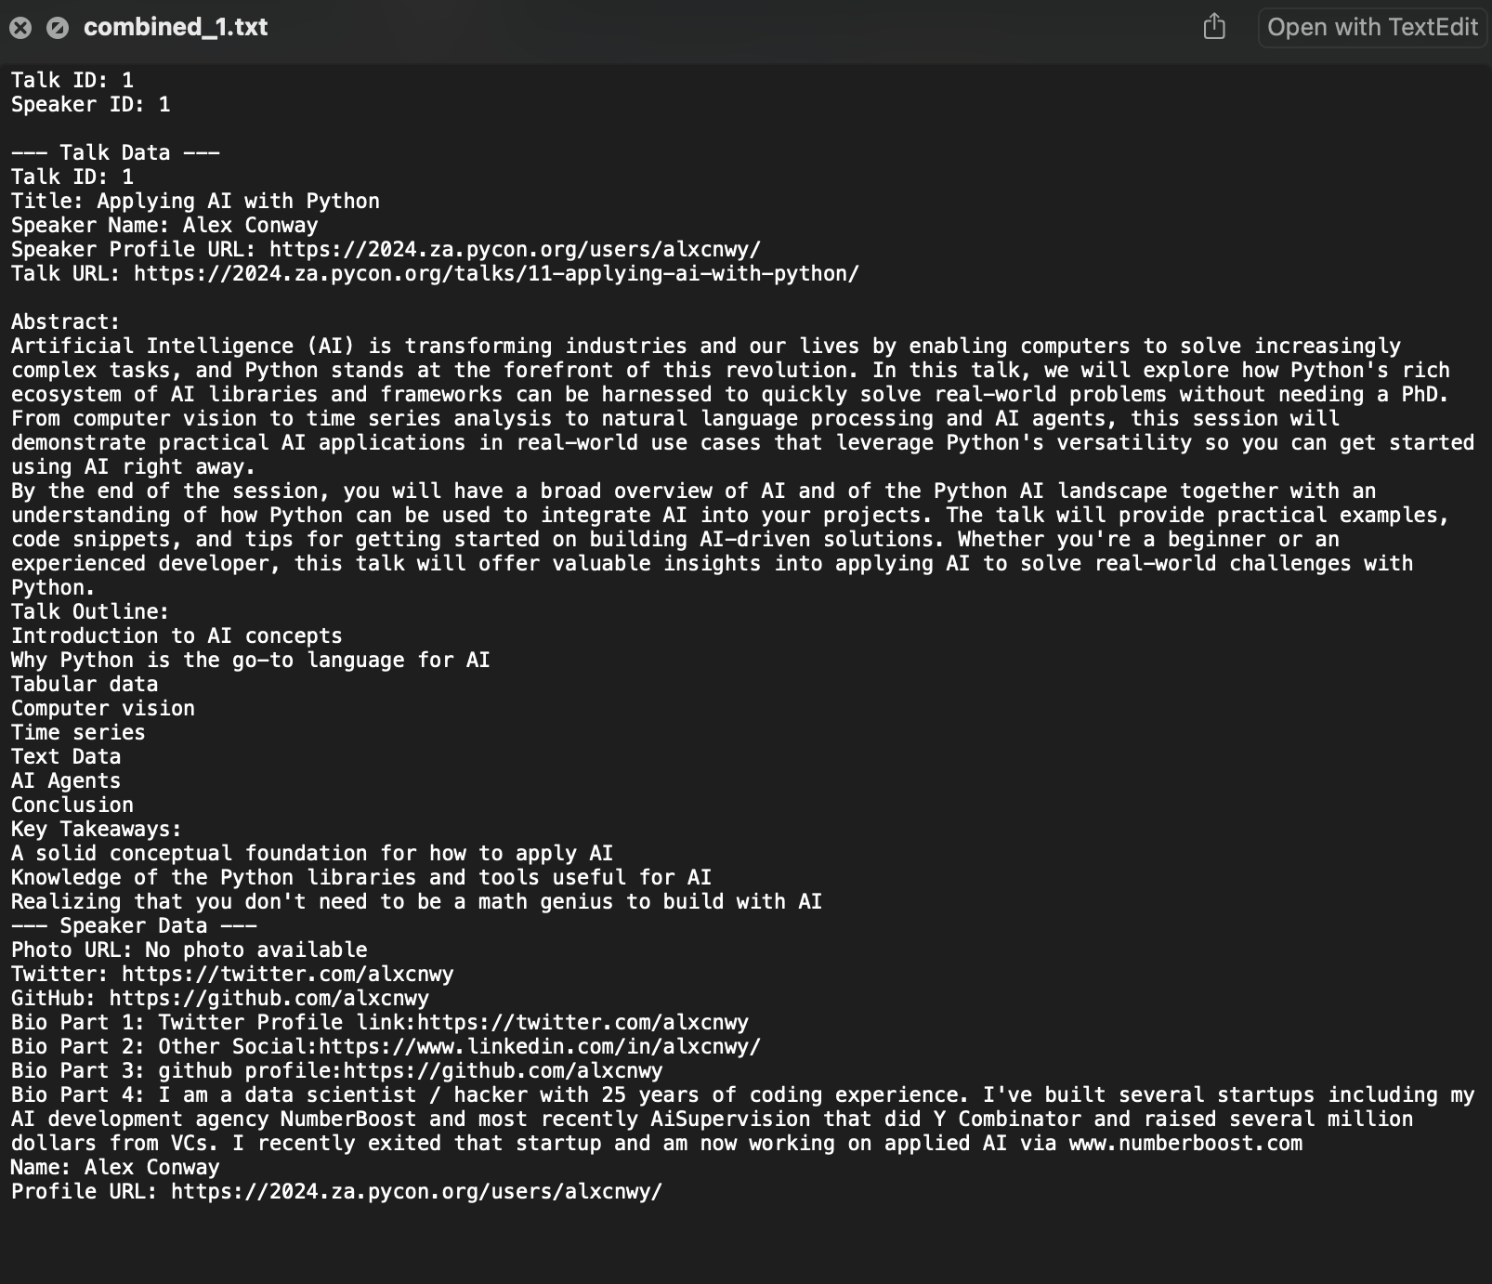

Slide 73
Jupyter Notebook
ETL – Load Documents into Database.ipynb

Slide 74
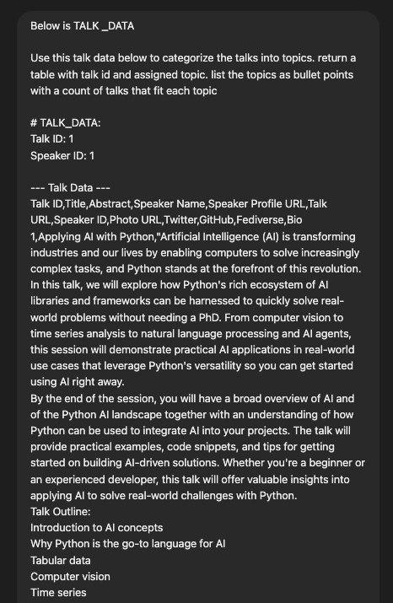
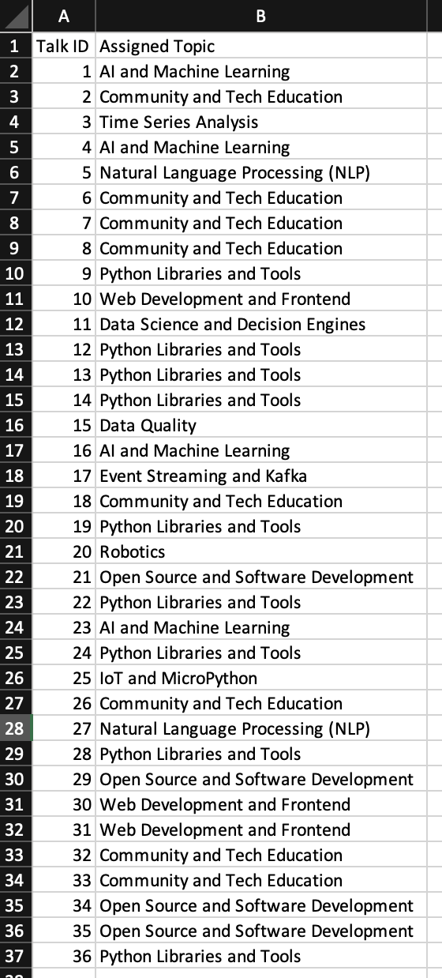

Slide 75
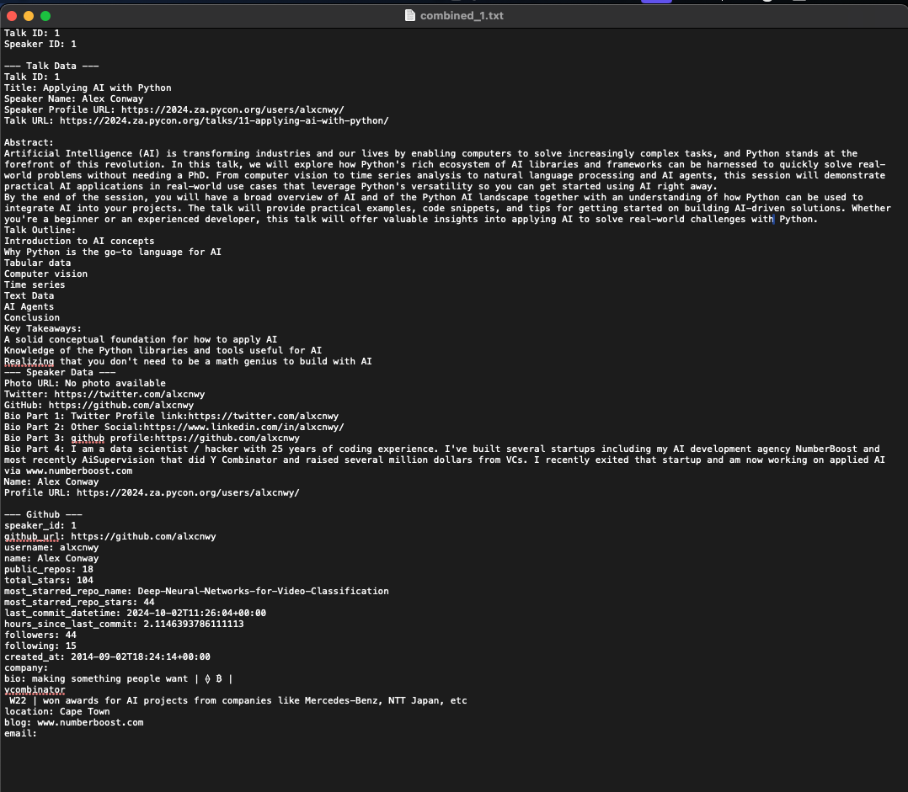

Slide 76
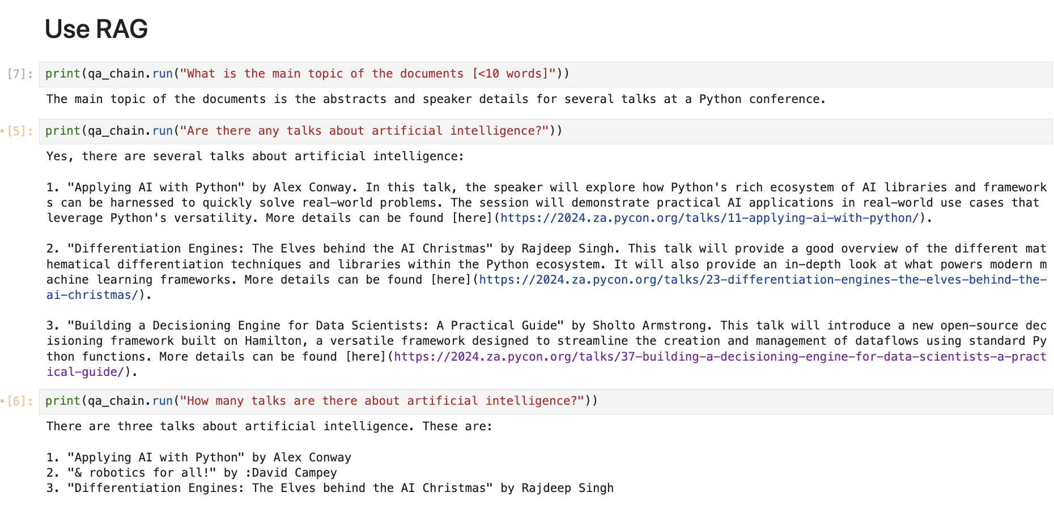

Slide 77
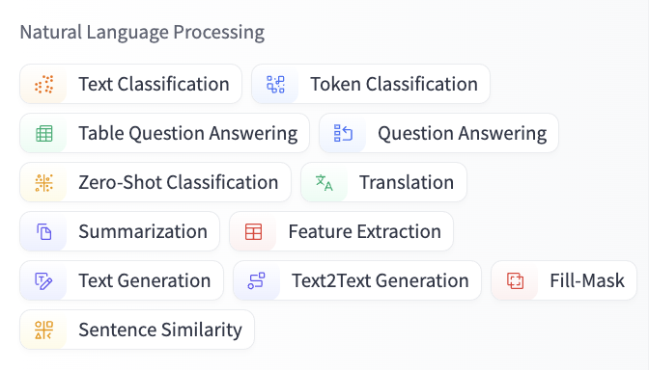

Slide 78
AI Agents

Slide 79
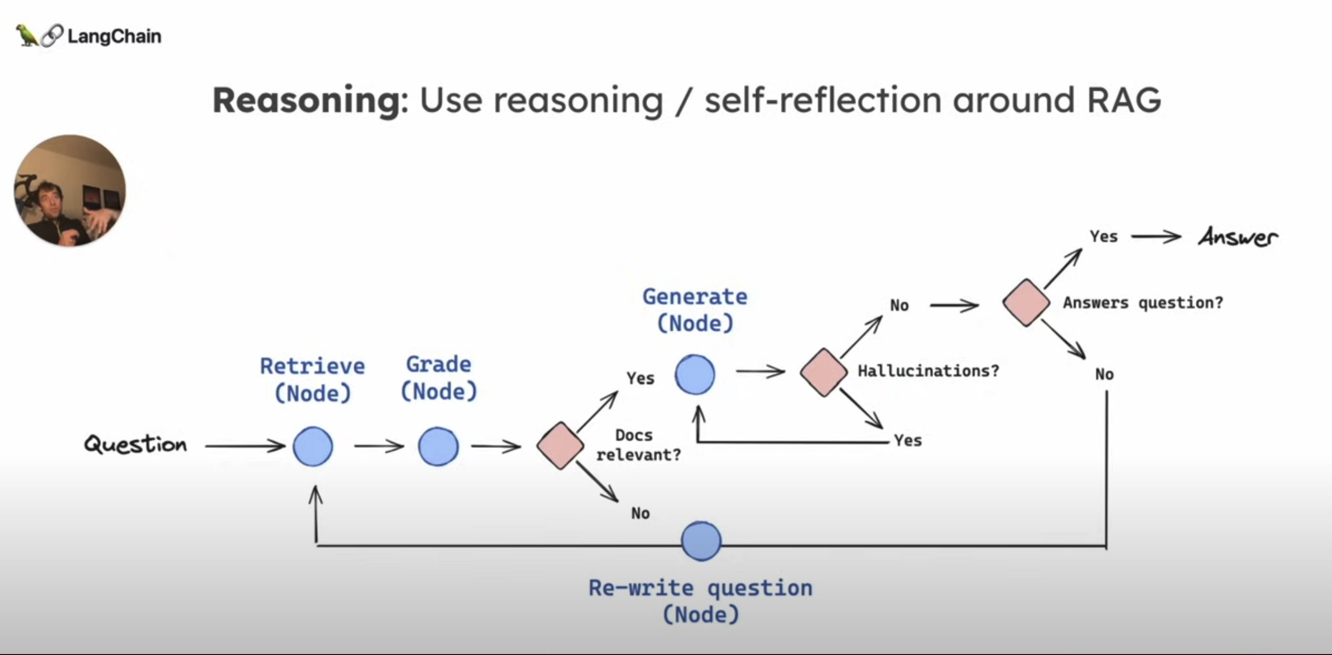

Slide 80
Remember the RAG model failed at this…

Slide 81
Our Agent Architecture
Todo: diagram
Agent
LLM checks if SQL or LLM should answer
If SQL
LLM writes SQL query with knowledge of database schema
Execute SQL
LLM takes SQL results and formulates markdown answer with analysis
If LLM
LLM writes answer using RAG
return answer

Slide 82


Slide 83


Slide 84
Jupyter Notebook
Agent.ipynb

Slide 85


Slide 86


Slide 87


Slide 88


Slide 89


Slide 90

Wrong!

Slide 91

Correct!

Slide 92


Slide 93


Slide 95


Slide 96
Conclusion

Slide 97


Slide 99
def ai_model(input):
#
# algorithms f(input) = output
#
return output

Slide 100



def ai_model(input):
#
#
#
return output

Slide 101
Thank You!
Alex Conway
alex@numberboost.com
x.com/alxcnwy

